Slide 1
The Memory System:Sensory Memory and Short-Term or Working Memory

Slide 2
General Plan
1960s Many models of memory proposed
Atkinson & Shiffrin (1968)-Modal Model
Sensory Memory
Short-term Memory
Long-term Memory

Slide 3
William James
Primary Memory
Secondary Memory

Slide 4
Atkinson & Shiffrin Model of Memory (1968)

Slide 5
Properties of the Different Memory Stores
Notes:
Forgetting in the Short-Term Store involves both interference and decay.
The capacity of the sensory registers vary for the different modalities: e.g. the visual sensory store is very large; the auditory sensory store is small (perhaps only 2 to 4 items)

Slide 6
Research on the A & S Model
Serial Position Effect
Recency Effect
Behavioral Neuroscience Evidence

Slide 7
Serial Position Effect Demo

Slide 8
Serial Position Effect Results

Slide 9
Serial Position Effect Graph
Primacy Effect
Recency Effect

Slide 10
Questions
How could we test the idea that the last few items are in STS?
How can we test that the primacy effect represents LTS?

Slide 11
Rundus (1971)

Slide 12
Serial Position Effect Graph - Psy 321 F2019
Primacy Effect
Where’s the recency effect ?
Why is our serial position curve different than the predicted shape?

Slide 13
Behavioral Neuroscience Evidence for the STM-LTM Distinction
H.M. - Epileptic
- Temporal Lobes / Hippocampus
- STM ---> LTM disrupted
K.F. - Damage to Left Cerebral Cortex
- LTM Normal
- STM capacity severely limited

Slide 14
Behavioral Neuroscience Evidence for the STM-LTM Distinction
The dog bit the man and the man died.
vs.
The man the dog bit died.

Slide 15
Atkinson & Shiffrin Model of Memory (1968)

Slide 16
The Sensory Store

Slide 17
Lightning

Slide 18
How long does the lightning last?

Slide 19
Lightning Demonstration

Slide 20
Sensory Memory
Sensory memory or sensory register
Visual, auditory, touch, taste, smell
Relatively raw, unprocessed form

Slide 21
Why Do We Need Sensory Memory?
Stimuli change
Maintain for selection and further processing
Integrate fragments of a stimulus into a single unitary perception

Slide 22
Classic Studies on Iconic Memory
Sperling (1960)
Averbach & Sperling (1961)

Slide 23
A Tachistoscope

Slide 24
Whole Report Procedure

Slide 25
Tachistoscopic Display - Blank

Slide 26
Fixation Point
*

Slide 27
Tachistoscopic Letter Display 1
J Z G B
S X P L
R M Q F

Slide 28
Tachistoscopic Display Blank 2

Slide 29
Partial Report Procedure

Slide 30
Tachistoscopic Display Blank 2

Slide 31
Fixation Point
*

Slide 32
Tachistoscopic Letter Display 2
Y Q C H
N D R J
V B K S

Slide 33
Tachistoscopic Display Blank 2

Slide 34
Tachistoscopic Letter Display 2
V B K S

Slide 35
Tachistoscopic Letter Display 2
N D R J

Slide 36
Tachistoscopic Letter Display 2
Y Q C H

Slide 37
Tachistoscopic Letter Display 2
Y Q C H
N D R J
V B K S
high
med
low

Slide 38
Schematic of Typical Sperling Exp

Slide 39
Number of Letters Recalled as a Function of Technique & Delay

Slide 40
Examples of Iconic Memory in Our Everyday Experience

Slide 41
Examples of Sensory Memory

Slide 42
Demo: Unitary Perception from Fragments

Slide 43
Videos & Movies

Slide 44
Auditory Sensory Memory
Neisser (1967) - Echoic memory and the echo
Darwin, Turvey, & Crowder (1972)
Differences from iconic memory
Crowder (1982)

Slide 45
An Echoic Memory Study

Slide 46
Properties of the Different Memory Stores
Notes:
Forgetting in the Short-Term Store involves both interference and decay.
The capacity of the sensory registers vary for the different modalities: e.g. the visual sensory store is very large; the auditory sensory store is small (perhaps only 2 to 4 items)

Slide 47
Short-Term Memory

Slide 48
Properties of the Different Memory Stores
Notes:
Forgetting in the Short-Term Store involves both interference and decay.
The capacity of the sensory registers vary for the different modalities: e.g. the visual sensory store is very large; the auditory sensory store is small (perhaps only 2 to 4 items)

Slide 49
Short-Term Memory
Duration
Nature of Forgetting
Nature of Code
Capacity

Slide 50
Short Term Memory
Brown/Peterson & Peterson (1959)
Trigram task

Slide 51
Trigrams
K X J
P L G
S Y T
H Z R

Slide 52
Brown-Peterson Results

Slide 53
STM--Nature of the code
Conrad (1964)
Visual display of letters
Phonological confusions: (‘D’ for ‘E’ but not ‘F’ for ‘E’)
Wickelgren (1965)

Slide 54
Wickelgren (1965)

Slide 55
STM Capacity Limited
Sensory Memory
Short-Term Memory
Long-Term Memory

Slide 56
Capacity of STM
Limited Capacity (7 + 2)
Digit Span Task

Slide 57
Listen to the following digit sequence and try to recall it when I say “Go”…
The digits I read:
1, 4, 9, 2, 1, 7, 7, 6, 2, 0, 1, 9
Did you notice?
1 4 9 2
1 7 7 6
2 0 1 9

Slide 58
By the way…
Try to recall all 12 digits now:
1, 4, 9, 2, 1, 7, 7, 6, 2, 0, 1, 9

Slide 59
Capacity of STM (cont.)
Recoding: (1 4 9 2 ----> ‘1492’ Columbus)
Chunking
Chase & Ericsson (1982)

Slide 60
SF DIGIT SPAN Experiment

Slide 61
SF Digit Span Experiment – 3 Sessions
Session 1 (Initial): (8 digits):
Session 3 (Much Later): (22 digits):
Digits:
1 0 5 3 1 8 7 4
Digits:
4 1 3 1 7 7 8 4 0 6 0 3 4 9 4 8 7 0 9 4 6 2
SF’s Recall:
105
SF’s Recall:
413.1
77.84
0603
31874
494
870
946.2
SF’s Report:
Blocked 1st set & rehearsal
SF’s Report:
4:13.1
mile time
Session 2 (Later): (11 digits):
06:03
mile time
9:46.2
2-mile time
Digits:
9 0 7 5 6 6 2 9 8 6 7
…
SF’s Recall:
907
566
Click to move on to next slide…
29867
SF’s Report:
9:07 a 2-mile time

Slide 62
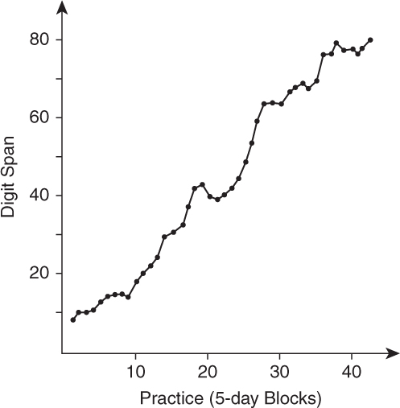
SF’s Digit Span as a Function of Practice

Slide 63
Do the SF results challenge the 7 plus or minus 2 idea about STM?

Slide 64
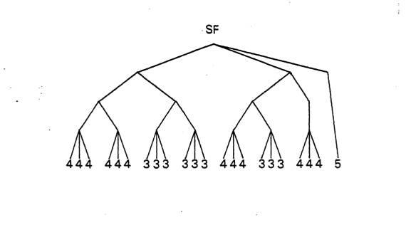
SF’s Retrieval Structure

Slide 65
Properties of the Different Memory Stores
Notes:
Forgetting in the Short-Term Store involves both interference and decay.
The capacity of the sensory registers vary for the different modalities: e.g. the visual sensory store is very large; the auditory sensory store is small (perhaps only 2 to 4 items)

Slide 66
Revisions to the STM Idea

Slide 67
Brown & Peterson - Revisited
Decay vs. Interference
Time and Interference Confounded in the Counting Backwards Task
How to dis-entangle?
Waugh & Norman (1965) - Digit Probe task
Varied Time and Interference Independently

Slide 68
Digit Probe Experiment: Waugh & Norman (1965)
1. Participants hear a series of 16 digits…
5
5
1
9
6
4
3
7
3
2
8
6
7
3
3
4
2. The last digit they hear is the probe.
3. As soon as they hear the probe digit, they must recall the last instance of the probe digit and the digit that followed it.

Slide 69
Trial Type 1: Vary the Time While Holding the Number of Intervening Digits Constant
8 seconds
1 digit/sec
5
5
1
9
6
4
3
7
3
2
8
6
7
3
3
4
2 seconds
4 digits/sec
5
5
1
9
6
4
3
7
3
2
8
6
7
3
3
4

Slide 70
Effect of Presentation Rate vs. Number of Interfering Items on Recall (Waugh & Norman, 1965)

Slide 71
Trial Type 2: Vary the Number of Intervening Digits While Holding Time Constant
2 seconds
4 digits/sec
5
5
1
9
6
4
3
7
3
2
8
6
7
3
3
4
2 seconds
1 digit/sec
5
5
1
9
6
4
3
7
3
2
8
6
7
3
3
6

Slide 72
Effect of Presentation Rate vs. Number of Interfering Items on Recall (Waugh & Norman, 1965)

Slide 73
Properties of the Different Memory Stores
Notes:
Forgetting in the Short-Term Store involves both interference and decay.
The capacity of the sensory registers vary for the different modalities: e.g. the visual sensory store is very large; the auditory sensory store is small (perhaps only 2 to 4 items)

Slide 74
Working Memory
Revision of STM
3-part system
Baddeley
Dual task paradigm

Slide 75
Baddeley Working Memory Model
Central Executive
- Plans & coordinates but does not store information.
- Focuses attention, selects strategies, transforms information, coordinates behavior
- Integrates information from other parts of the system
Phonological Loop
Visuospatial Sketchpad
- Processes and stores a limited number of items (3 or 4) for short time
- Maintains information as sounds (esp. speech sounds) using rehearsal
- Executive resources drained if rehearsal task is difficult
- Processes visual and spatial information
- Limited capacity
- Executive resources drained if visual imagery or spatial task is difficult

Slide 76
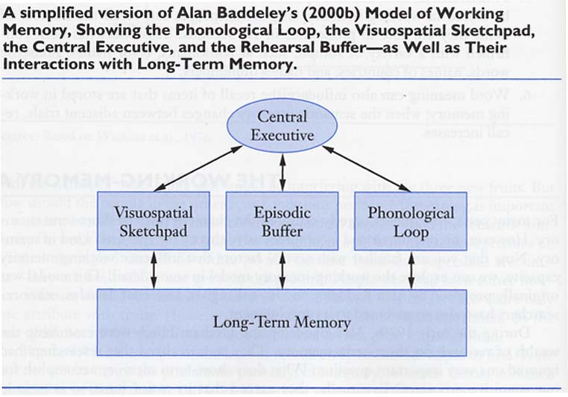
Working Memory Model with Episodic Buffer & Long-Term Memory

Slide 77
Reasoning Task with Letter Recall
AB
‘A’ precedes ‘B’? T or F
‘B’ is preceded by ‘A’ . T or F
‘B’ does not precede ‘A’. T or F

Slide 78
Reasoning Speed and Letter Recall

Slide 79
Reasoning Times & Letter Recall Results

Slide 80
Bradimonte Et al. (1992)

Slide 81
Brandimonte (1992)
Condition 1
Condition 2
1. Study 6 pictures
1. Study 6 pictures while saying “la, la, la . . .”
2. Create mental image, subtract a specific part, and name it.
2. Create mental image, subtract a specific part and name it.
?
Fish
Result?
3. Number of correct items: 2.7
3. Number of correct items: 3.8

Slide 82
Pronunciation Time & Memory Span
Read the following words. When you have finished look away and try to remember them:
England, Burma, Greece, Spain, Iceland, Malta, Laos
Again read the words, look away and try to remember them:
Czechoslovakia, Switzerland, Nicaragua, Afghanistan, Venezuela, Philippines, Madagascar

Slide 83
Pronunciation Time & Memory Span
Read the following words. When you have finished look away and try to remember them:
England, Burma, Greece, Spain, Iceland, Malta, Laos
Again read the words, look away and try to remember them:
Czechoslovakia, Switzerland, Nicaragua, Afghanistan, Venezuela, Philippines, Madagascar

Slide 84
Memory Span and Pronunciation Rate

Slide 85
Capacity of STM

