Slide 1
Perception & Pattern Recognition
  Sensation
  Perception
  Pattern Recognition
  Theories of Pattern Recognition
  Bottom-up vs. Top-Down Processing & Pattern Recognition

Slide 2
Sensation
Process by which our senses (e.g. vision, audition) register external stimuli.
Sensation is bottom-up or stimulus-driven processing.
Unaffected by your knowledge (e.g. ‘K’ is not the letter K but dark and light information)

Slide 3
Perception
Process that uses our previous knowledge to gather and interpret stimuli that our senses register
Perception uses bottom-up (stimulus-driven) and top-down (knowledge-driven) information processing.

Slide 4
Pattern Recognition
Perceptual identification of a complex arrangement of sensory stimuli
The stimulus ‘K’ is recognized as a familiar pattern – i.e. the letter ‘K’
A series of musical notes recognized as a melody or musical phrase

Slide 5
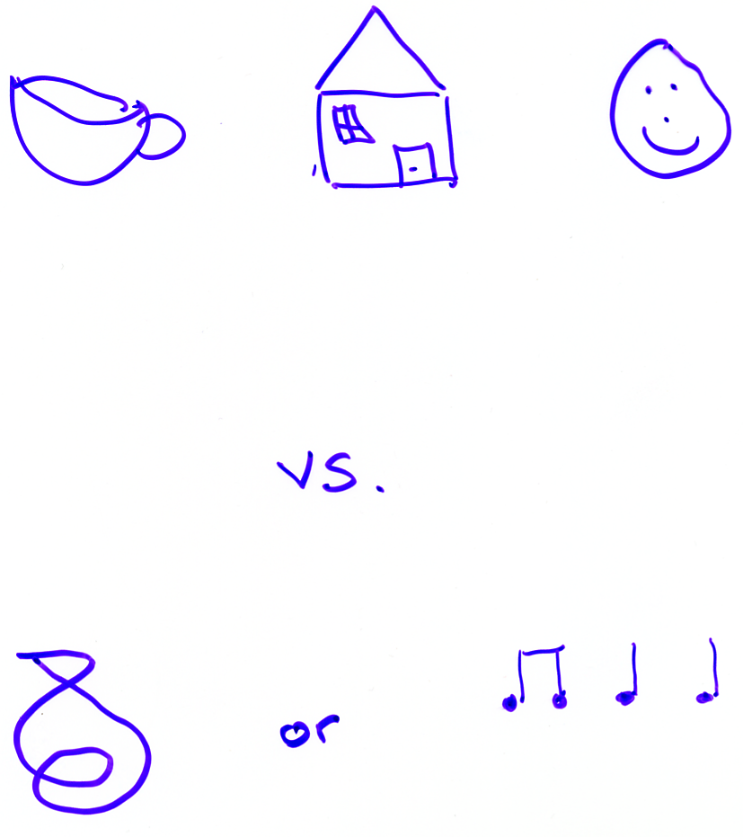
Patterns

Slide 6
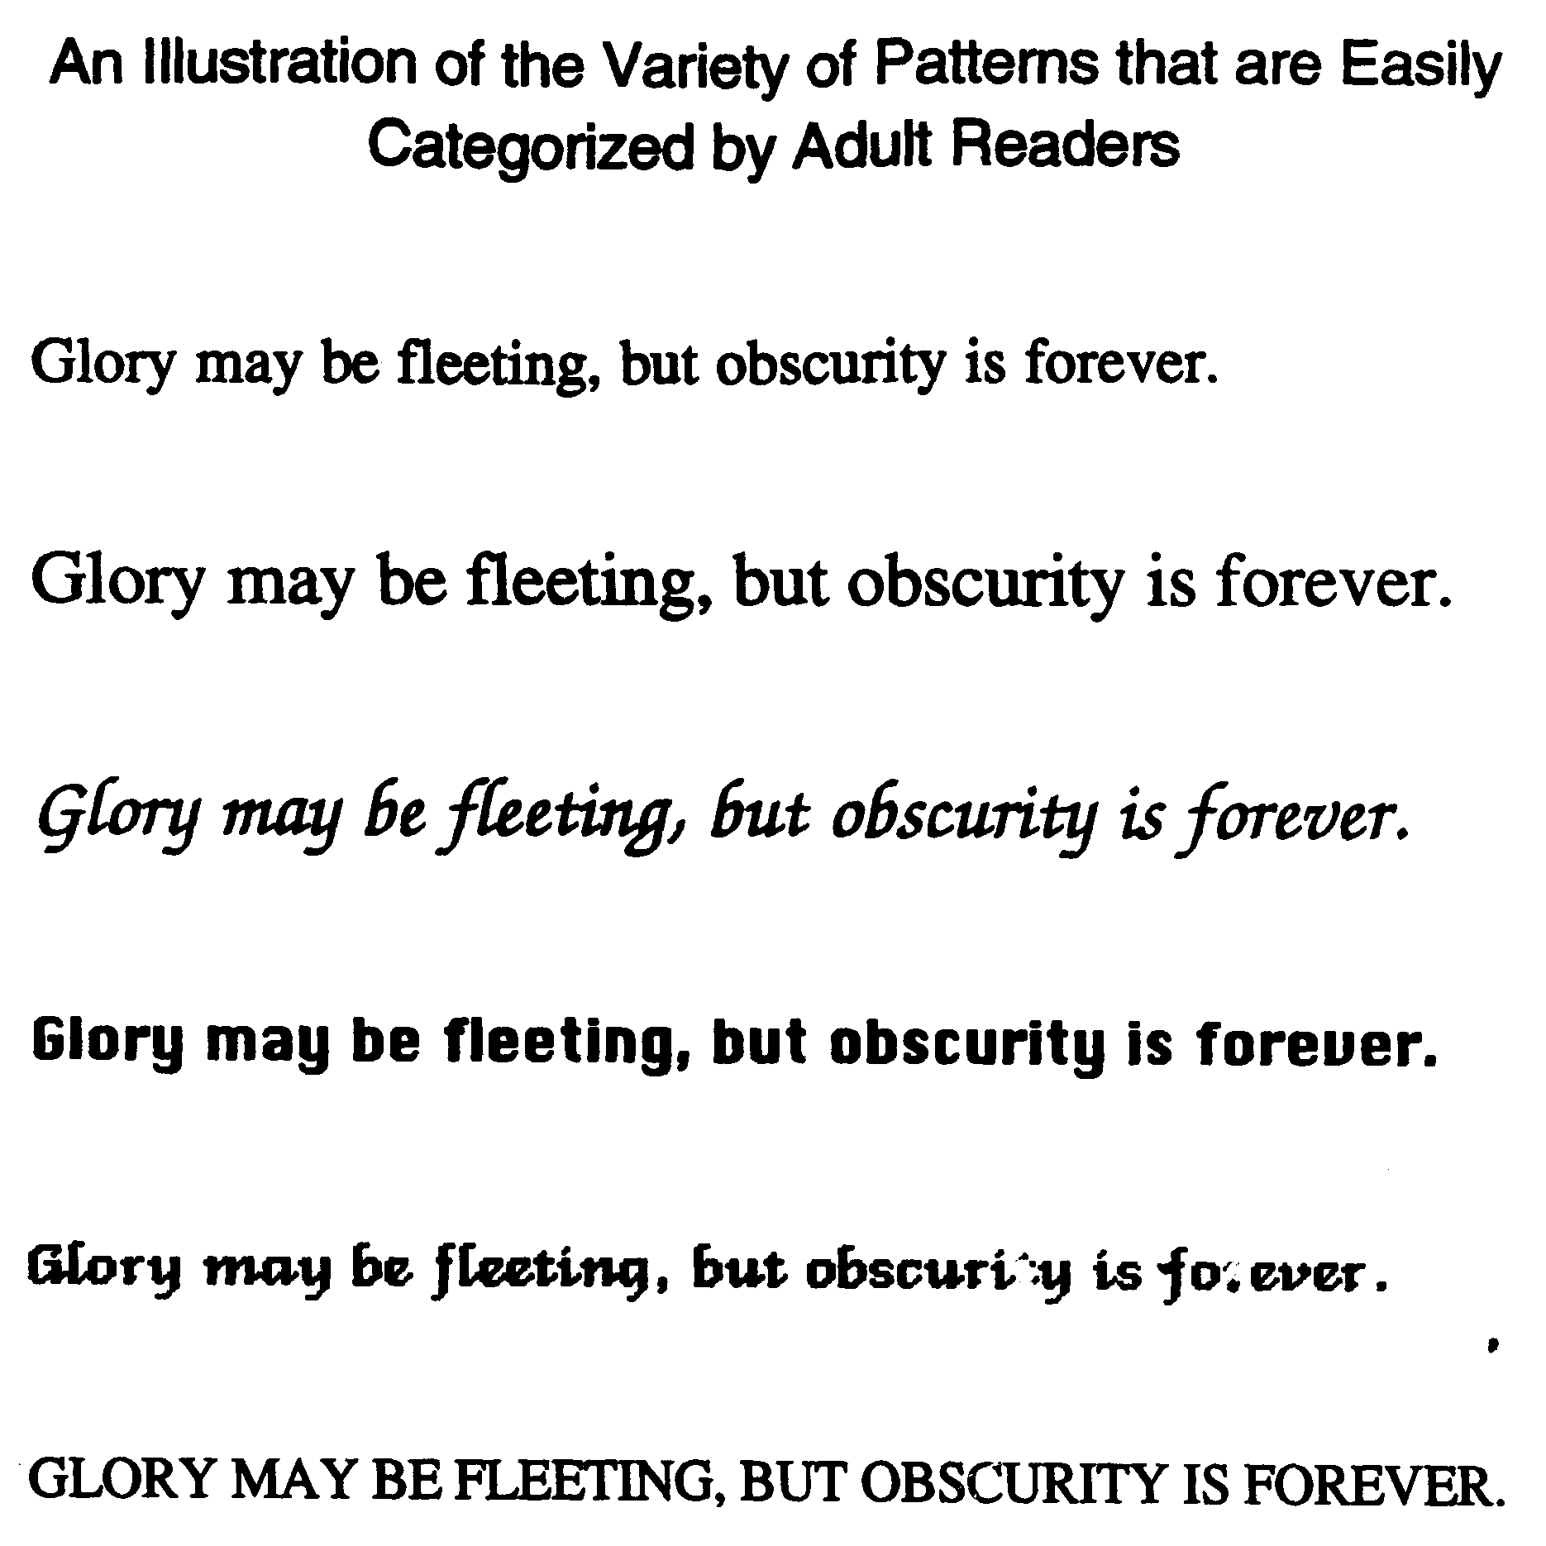
Glory may be fleeting…

Slide 7
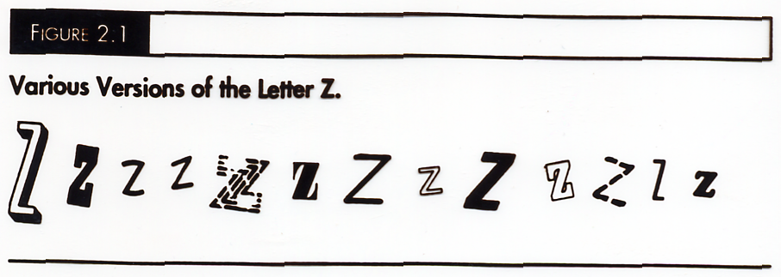
The Letter Z

Slide 8
Theories of Pattern Recognition
Template Matching Theories
Distinctive Features Theories
Recognition by Components Model

Slide 9
Template Matching Theory
Compare a new stimulus (e.g. ‘T’ or ‘5’) to a set of specific patterns stored in memory
Stored pattern most closely matching stimulus identifies it.
To work – must be a single match
Used in machine recognition

Slide 10
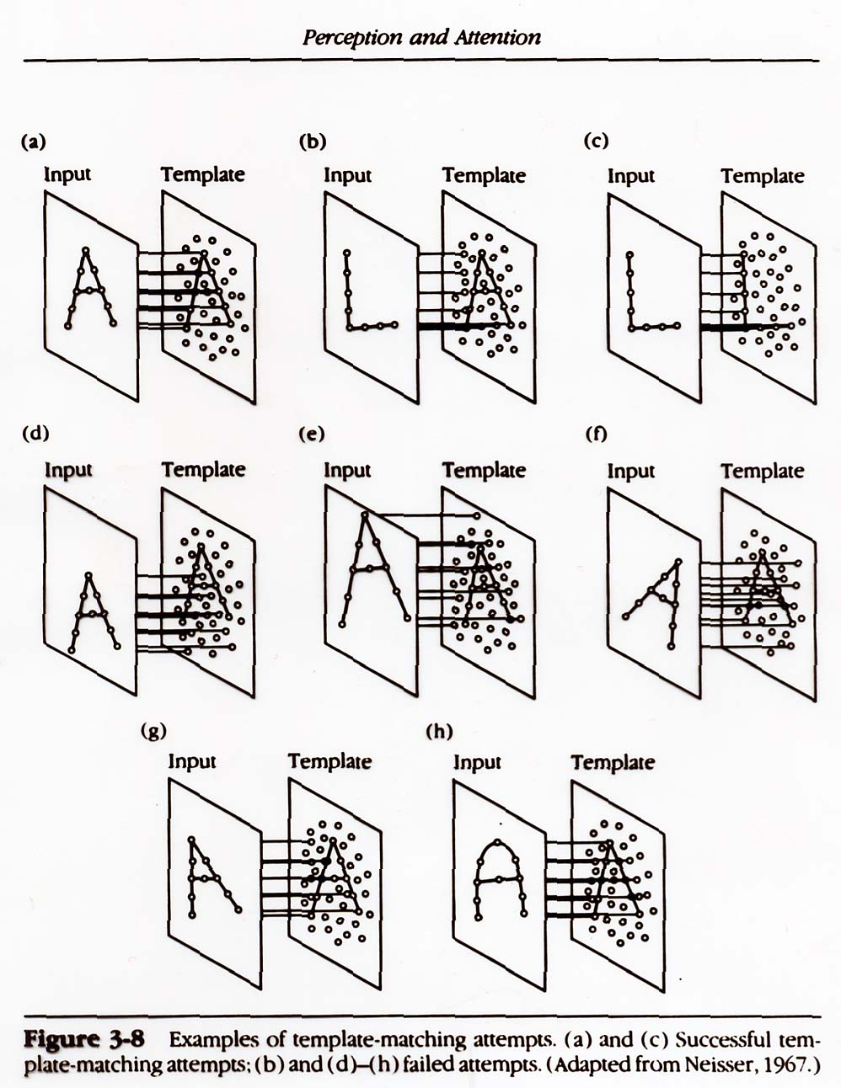
Examples of Template Matching Attempts

Slide 11
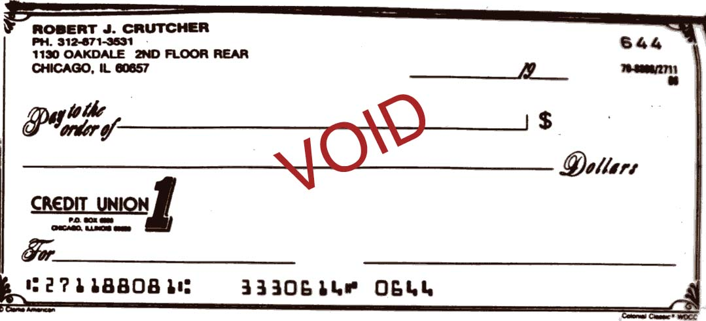
Used in machine recognition

Slide 12
Problems for Template Matching
Inefficient - large # of stored patterns required
Extremely inflexible
Works only for isolated letters and simple objects

Slide 13
Distinctive Features Models
Comparison of stimulus features to a stored list of features
Distinctive features differentiate one pattern from another
Can discriminate stimuli on the basis of a small # of characteristics – features
Assumption: feature identification possible

Slide 14
Distinctive Features Models: Evidence
Consistent with physiological research
Psychological Evidence
  Gibson 1969
  Neisser 1964
  Waltz 1975
  Pritchard 1961

Slide 15
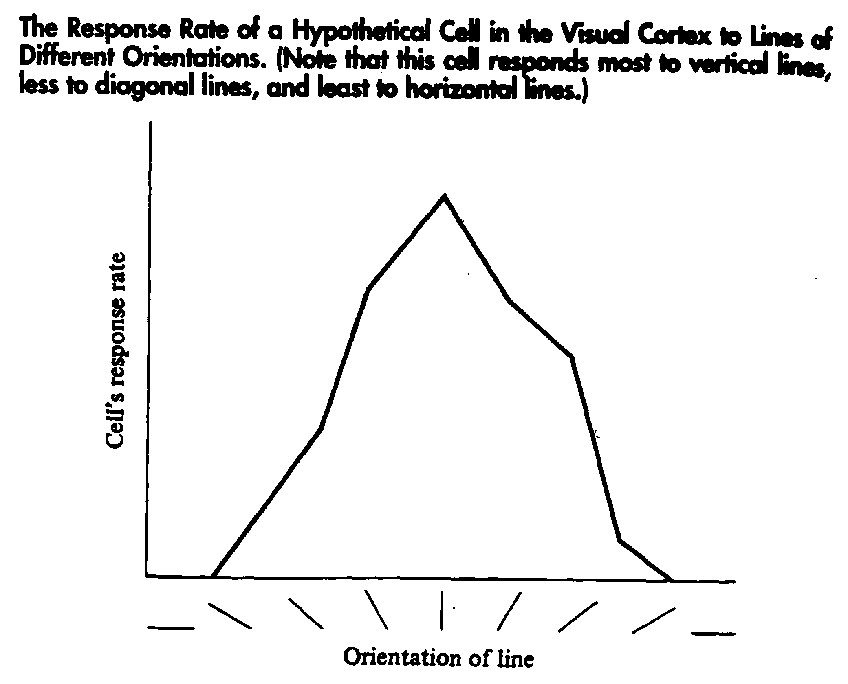
Visual Cortex Cell Response

Slide 16
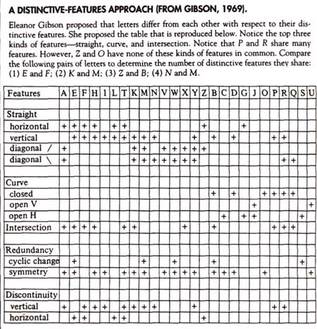
Gibson--Distinctive Features

Slide 17
Can we empirically test the distinctive features theory?
In other words, can we show that we must be processing features when we identify and distinguish one pattern from another – e.g. letters?
There are many ways we can test a feature-based theory.
For example:

Slide 18
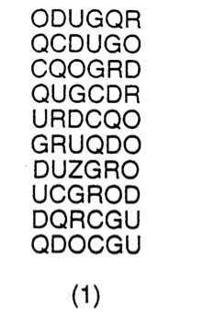
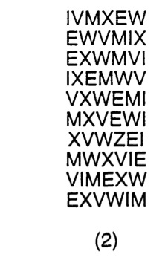
Scan for the letter ‘Z’ in the first column of letter strings.
Scan for the letter ‘Z’ in the second column of letter strings.
Where did you find the ‘Z’ faster: in column 1 or 2? What does this show?
Notes:
Ask them whether a template based theory or model could explain this difference?

Slide 19
How a Distinctive Features Model Might Work:
A
Z
T

Slide 20
Letter Detection Task
Decide whether the pair of letters are the same or different: Yes or No

Slide 21
Letter Pairs
L T
T T
K M
G N
S T
G G

Slide 22
Task Analysis and Predictions (based on distinctive features model)
Focus on the letter pairs that are different (there are 4 of them: LT, KM, GN, and ST)
Which would produce the fastest ‘different’ decision RT? The slowest? Why?
Can you order the 4 pairs (fastest to slowest)? Explain your reasoning.
What is the purpose of the ‘same’ pairs (e.g. T T) in the experiment?
L T
T T
K M
G N
S T
G G

Slide 23
Distinctive Features - Summary
Theory must specify how the features are combined/joined
These models deal most easily with fairly simple stimuli -- e.g. letters
Shapes in nature more complex -- e.g. dog, human, car, telephone, etc
What would the features here be?

Slide 24
Recognition by Components Model
Irving Biederman (1987, 1990)
Given view of object can be represented as arrangement of basic 3-D shapes (geons)
Geons = derived features or higher level features
In general 3 geons usually sufficient to identify an object

Slide 25
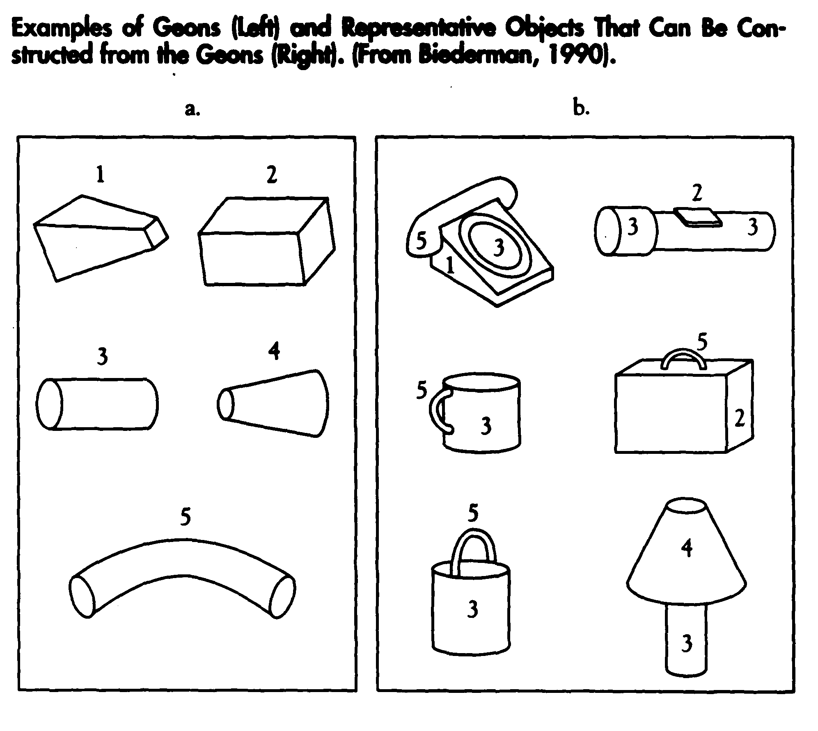
Examples of Geons

Slide 26

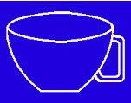

Recognition by Components
Pro – Biederman found that obscuring vertices impairs object recognition while obscuring other parts of objects has a lesser effect.
Which is easiest to recognize as a cup? The left or right?
Con – Biederman – Not all natural objects can be decomposed into geons. What about a shoe?

Slide 27
Summary
Distinctive Features and Recognition by Components currently strongest theories
Evidence from cognitive experiments and cognitive/behavioral neuroscience.
However, pattern recognition is too rapid and efficient to be completely explained by these models

Slide 28
Thought Experiment
Assume each letter 5 feature detections involved
Page of text approximately 250-300 words of 5 letters per word on average
Each page: 5 x 5 x 250-300 = 6250 - 7500 feature detections
Typical reader 250 words/min reading
6250/60 secs =100 feature detections per second

Slide 29
Two types of Processing
Bottom-up or data-driven processing emphasizes stimulus characteristics
Top-down or conceptually driven processing-emphasizes prior knowledge, expectations, memory
Most cognitive tasks involve both bottom-up and top-down processing

Slide 30

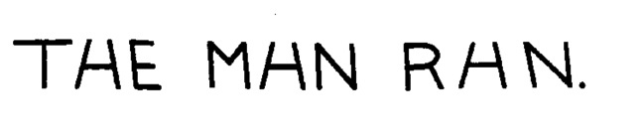
What letter is this?

Slide 31


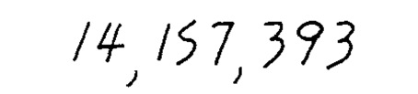
Read this

Slide 32
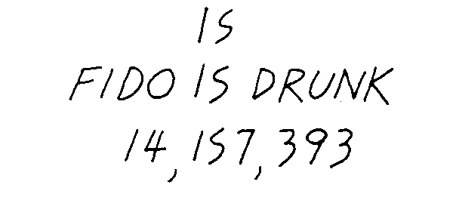
Fido is Drunk

Slide 33
Word Superiority Effect
We can identify a single letter more rapidly and more accurately when it appears in a word than when it appears in a non-word.

Slide 34
Demonstration

Slide 35
Identifying a letter
Your task: Identify the letter at the end of each word (’D’ or ‘K’)
The target letter will always occur at the end of the string of letters.
The string may be a word (e.g. book) or a nonword (e.g. obok)

Slide 36
What letter do you see?
OWRD

Slide 37
What letter do you see?
WORK

Slide 38
What letter do you see?
WROK

Slide 39
What letter do you see?
WORD

Slide 40

You saw each of these 4 strings
OWRD
WORK
WROK
WORD

Slide 41
Word Superiority Effect
We can identify a letter (e.g. ‘k’) more rapidly when it appears in a word (e.g. ‘work’) than when it appears in a non-word (e.g. ’wrok’).

Slide 42
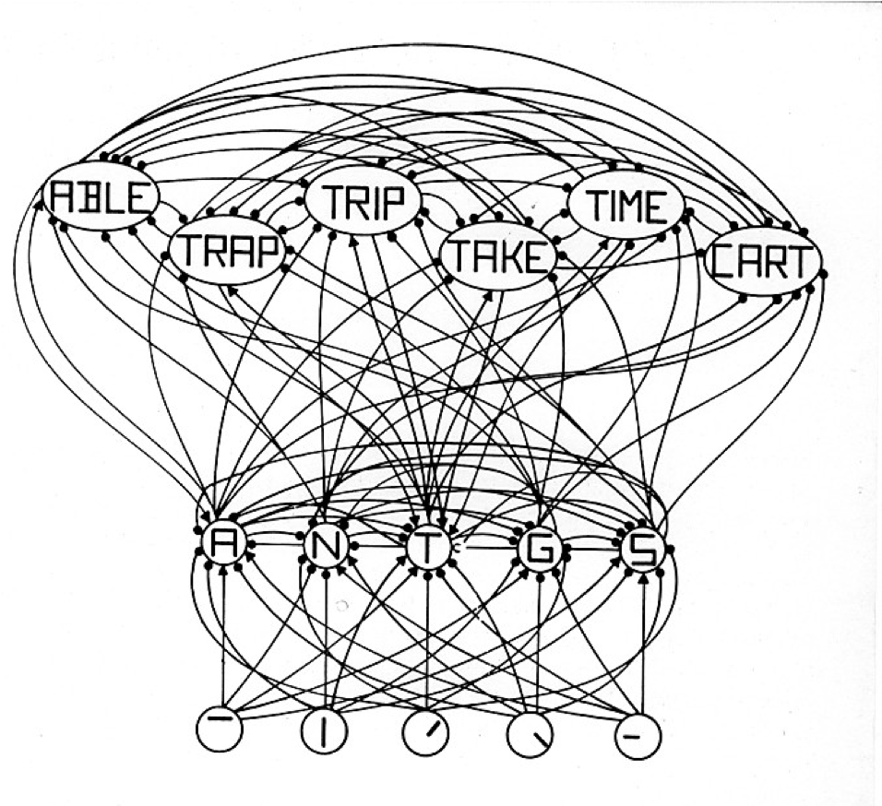
Interactive Activation Model of the Word Superiority Effect (McClelland & Rumelhart, 1981)

Slide 43
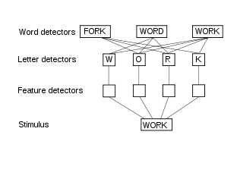
Interactive Activation McClelland Model of the Word Superiority Effect (& Rumelhart, 1981)

Slide 44
What if?

Slide 45
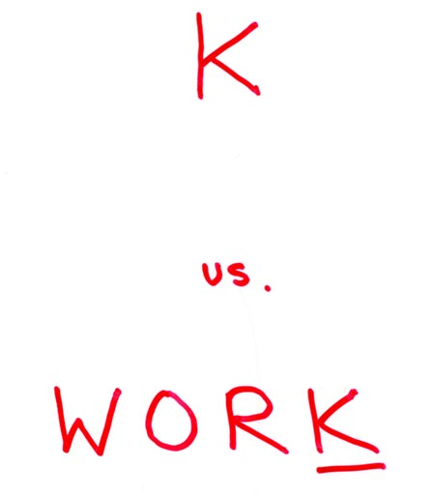
Single Letter ‘K’ vs ‘K’ in a word

Slide 46
What letter do you see?
K

Slide 47
What letter do you see?
WORD

Slide 48
What letter do you see?
WORK

Slide 49
What letter do you see?
D

Slide 50
How surprising!
We recognize a single letter (e.g. ‘k’) faster when it is embedded in a word (e.g. ‘work’)
  For example: ‘work’
Than when it appears all by itself:
  For example: ‘k’

Slide 51
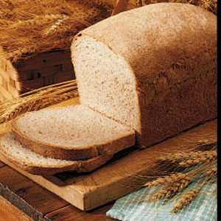
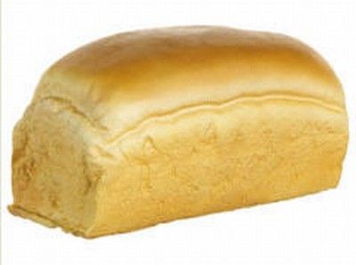
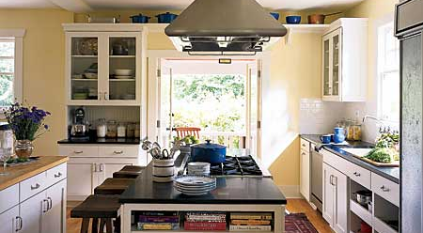
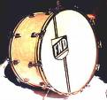

Palmer (1975)
Palmer (1975) using stimuli like the picture of the kitchen first present a scene context and then briefly flashed a picture of an object (e.g. the drum, the bread, or the mailbox). Subjects were asked to identify the object. Subjects correctly identified objects appropriate to the scene (like the loaf of bread) 80 percent of the time versus 40 percent of the time for the objects that did not fit into the scene.

Slide 52
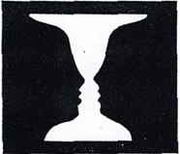
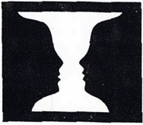
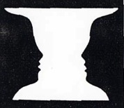
What do you see?
When the white area is smaller, the vase is more likely to be seen.
You may see a pair of black faces or a white vase.
When the black area is smaller, the faces are more likely to be seen.

Slide 53
Specialized Visual Recognition Processes – Face Recognition

Slide 54
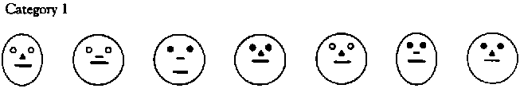
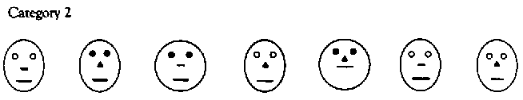
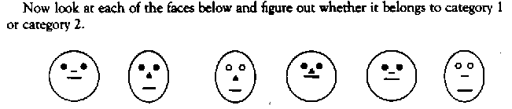
Forming Prototypes Faces--Faces Animated Version
Examine the faces below, which belong to two different categories.

Slide 55
Forming Prototypes Faces--Faces Animated Version
Examine the faces below, which belong to two different categories.

Slide 56
Prototype Theories
Store abstract, idealized patterns (or prototypes) in memory
Summary - some aspects of stimulus stored but not others
Matches need not be exact

Slide 57
Prototypes - Evaluation
Family resemblances (e.g. birds, faces, etc.)
Evidence supporting prototypes
Problems - Vague; less well-specified theory of pattern recognition

Slide 58
Recognizing Faces vs. Recognizing Other Objects
Face perception as “special”
Tanaka & Farah – facial features in context vs. isolation
Individual feature identification vs. holistic or configural recognition
Like a gestalt

Slide 59
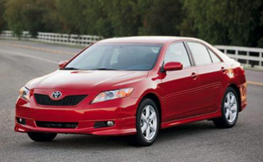
Do you recognize this object

Slide 60

Do you recognize this object?

Slide 61
Do you recognize this face?

Slide 62
Do you recognize this face?

Slide 63
Do you recognize this face?

Slide 64
Do you recognize this face?

Slide 65
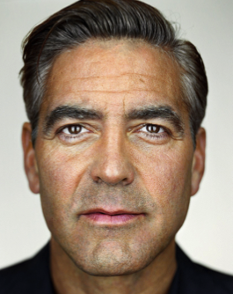
Do you recognize this face?

Slide 66
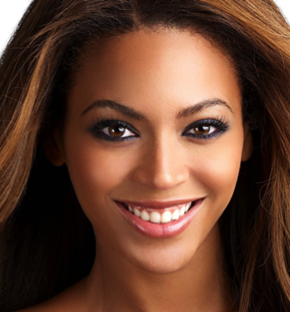
Do you recognize this face?

Slide 67
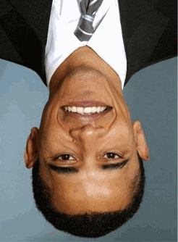


Slide 69
Cognitive Neuroscience Research on Face Recognition
Fusiform Face Area in temporal cortex
Face recognition cells in monkeys
fMRI studies
  Brain responses to faces in upright versus inverted (upside-down) position
  Face Inversion Effect
Prospagnosia

Slide 70
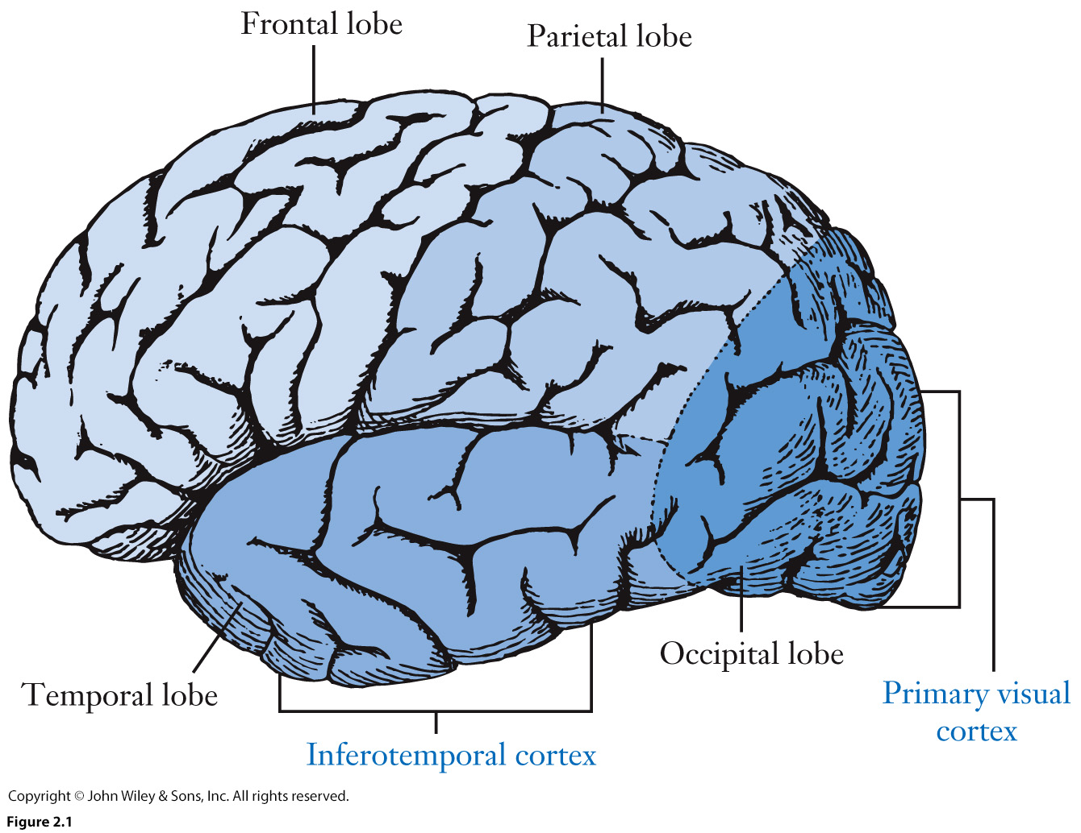
Cerebral Cortex, as Seen from the Left Side, Showing 4 Lobes of the Brain

Slide 71
Holistic Face Detection

