Slide 1
Improving Memory: Memory Strategies and Metacognition
Memory Strategies
  Previous Chapters
  Practice
  Imagery Mnemonics
  Organizational Mnemonics
  Multimodal Approach
  Prospective Memory
Metacognition
  Metamemory
  TOT
  Metacomprehension

Slide 2
Apply What We’ve Learned So far...
Divided Attention
Working Memory (Limited Capacity)
Levels of Processing
Elaboration
Self-Reference
Encoding Specificity Principle
Expertise and the Skilled Memory Effect

Slide 3
Practice
Total Time Hypothesis
Distributed vs. Massed Practice
Desirable Difficulty
Expanded Retrieval Practice
Testing Effects (eg. Roediger et al. 2010; Roediger & Karpicke, 2006b)

Slide 4
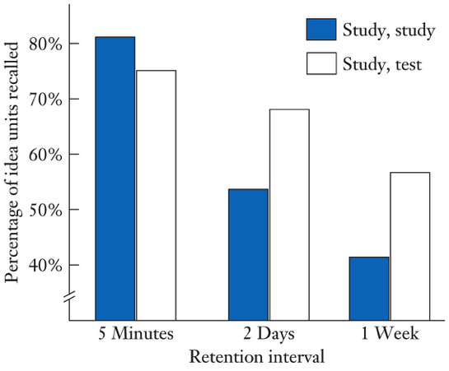
Testing Effects
The Effect of Learning Condition (Repeated Study vs. Testing) and Retention Interval on Recall (Roediger & Karpicke, 2006)

Slide 5
Practice
Deliberate Practice
Domain-Specific vs. General

Slide 6
Mnemonics
Mnemonics are techniques for learning & remembering arbitrary or difficult to learn information or material.

Slide 7
Two General Types of Mnemonics
Mnemonics
Imagery Mnemonics
Organizational Mnemonics

Slide 8
Visual Imagery Mnemonics
What is Imagery?
Types of Imagery – Visual, Auditory, Gustatory
Visual Imagery – Effective
Bizarre Imagery Effectiveness – Potential Confounds
Interactive Visual Imagery – extremely effective

Slide 9
Interactive Visual Imagery
Demonstration

Slide 10
Interactive Visual Imagery Mnemonics
The Keyword Method
The Method of Loci
The Pegword Method

Slide 11

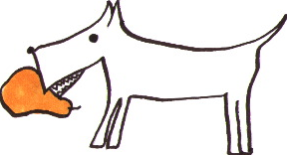
Keyword Method
Spanish
Keyword
English
Image
Perro
Pear
Dog
The keyword method is a mediational technique that involves first relating a Spanish word (perro) to a similar-sounding English word called the keyword (pear) and then relating the keyword to the English definition (dog) by generating an interactive visual image involving the two referents.

Slide 12
How to Use the Method of Loci to Remember a List of Items
Select a route that consists of a series of locations – these are your ”loci.”
Associate the word for each item with one of the locations as you mentally ‘walk’ your path.
Try to form an interactive visual image involving the item and the location.
To remember your list of items, retrace your path or route and simply retrieve your item by looking at each location as you retrace your path.

Slide 13


Slide 14
Organizational Mnemonics

Slide 15
Organizational Mnemonics
Chunking
Hierarchies
First-Letter Mnemonic
Narrative Technique

Slide 16
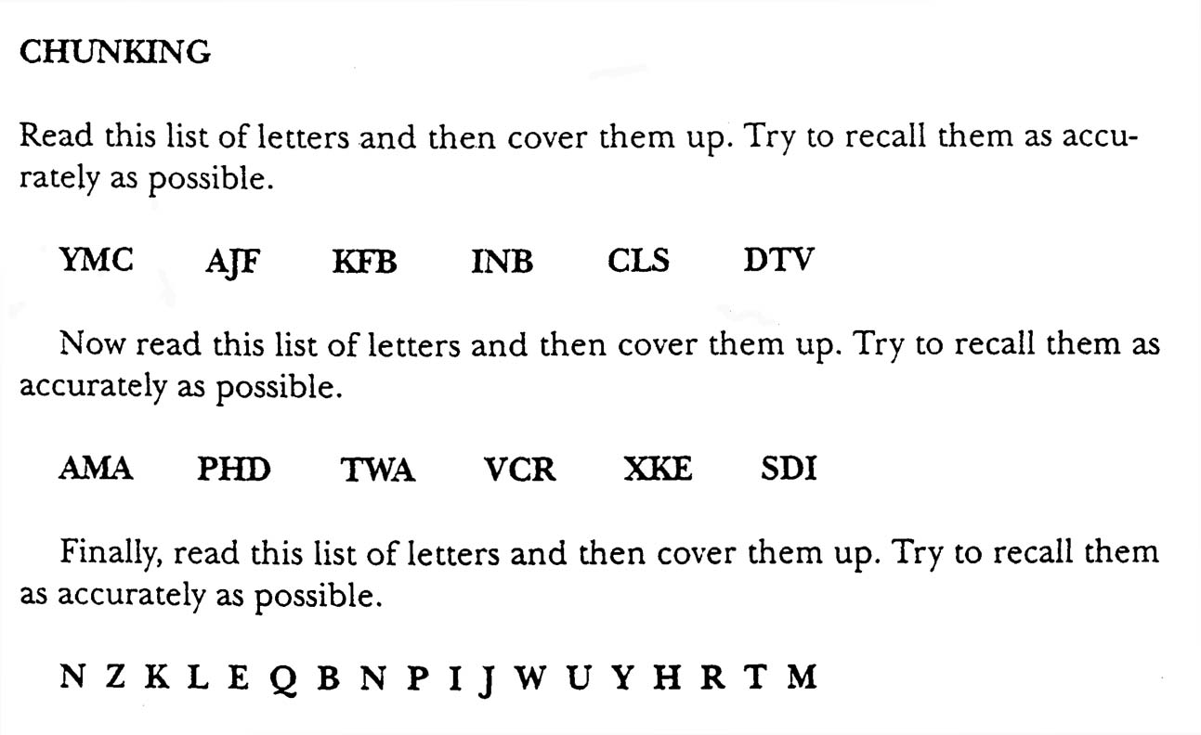

Slide 17
Hierarchical Technique

Slide 19
Bower (1969)

Slide 20
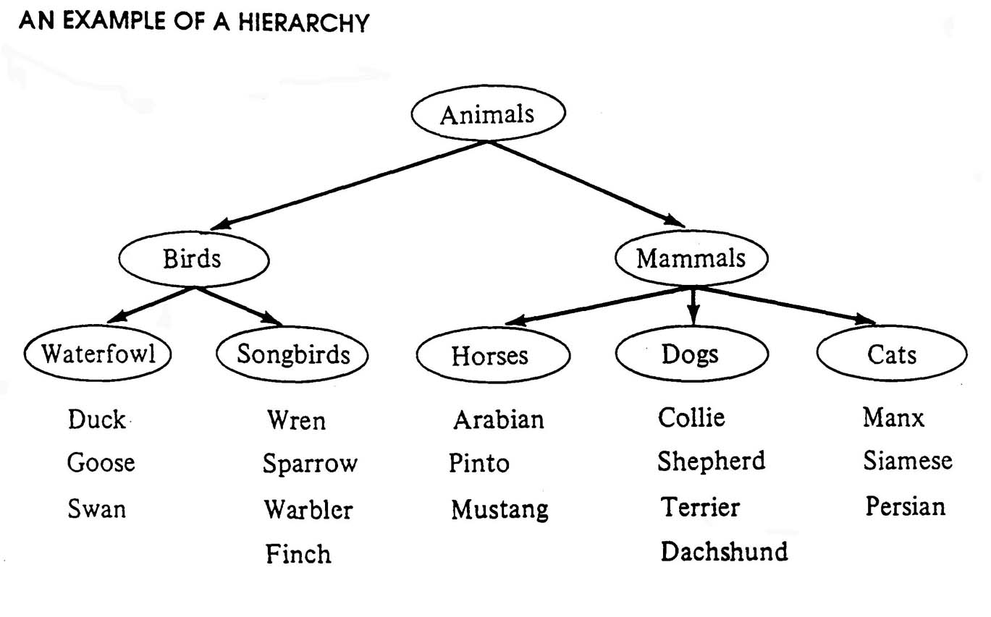

Slide 22
First-Letter Mnemonic
Examples:
ROY G BIV
  Red, Orange, Yellow, Green, Blue, Indigo, Violet
HOMES
  Huron, Ontario, Michigan, Erie, Superior

Slide 23
Narrative Technique
Make up a story that links a series of words together
Bower & Clark (1969)
  Six times as many words recalled by narrative group
Narrative must be sensible and hang together as a story

Slide 24
Multimodal Approach
Mnemonics Alone – Limited Application
Comprehensive approach needed
Physical and Mental Factors
Memory Attitude
No one device or technique

Slide 25
Improving Prospective Memory
Definition
Retrospective vs. Prospective
  Differences
  Similarities
Prospective Memory Research
  Ecological validity
  Currency
Absentmindedness
  Schemas and routines
  Time pressures
Improving Prospective Memory

Slide 26
External Memory Aids
Any device, external to the person, that facilitates memory in some way
Examples
Retrieval cues always present

Slide 27
Metacognition
My knowledge, awareness, and control of my cognitive processes
Knowledge of the factors that influence my cognitive process
Awareness of my preparation and level of understanding
Control over my cognitive activities
Strategy selection, monitoring, etc.

Slide 28
Metacognition Topics
Metamemory
Tip of the Tongue
Metacomprehension

Slide 29
Metamemory
Definition
Accuracy
Lovelace (1984)
  Paired associates (ex: disease - railroad)
  4 conditions
    Each pair 8 seconds single trial
    Each pair 4 seconds 2 successive trials
    Each pair 2 seconds 4 successive trials
    Each pair 4 seconds 2 successive trials with a test trial in between

Slide 30
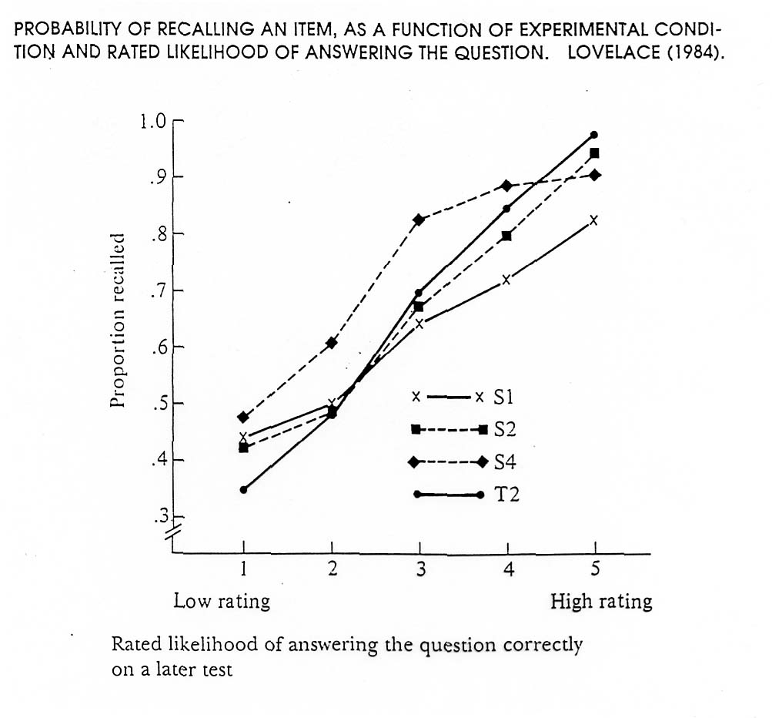
Lovelace (1994) Results

Slide 31
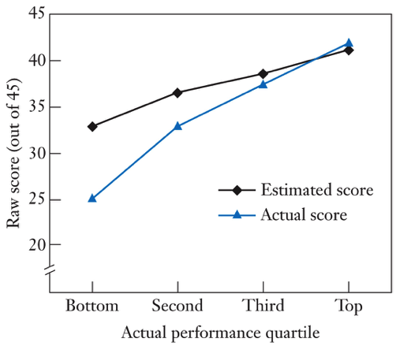
Estimated Total Score vs. Actual Total Score as a Function of Actual Test Performance
Johnson, D.D., Ehrlinger, J., & Kruger, J. (2003)

Slide 32
When Metamemory Accuracy Is Likely To Be High:
Easy vs. Difficult material
Individual Items vs. Overall Score
Delayed vs. Immediate judgments
Intentional vs. Incidental learning
Overlearned Material

Slide 33
Relationship Between Metamemory and Memory Performance
  Leal (1987) : questionnaire study
  Methodological and measurement issues
Awareness of factors affecting memory
  Suzuki & Slater (1988)
Regulating study strategies
  Allotment of time
  Immediate vs. Delayed assessment
  Cull & Zechmeister (1994)

Slide 34
Cull & Zechmeister (1994)
unusual word - easy word
  e.g. fugue - chair
unusual word - hard word
  e.g. rheum - siege

Slide 35
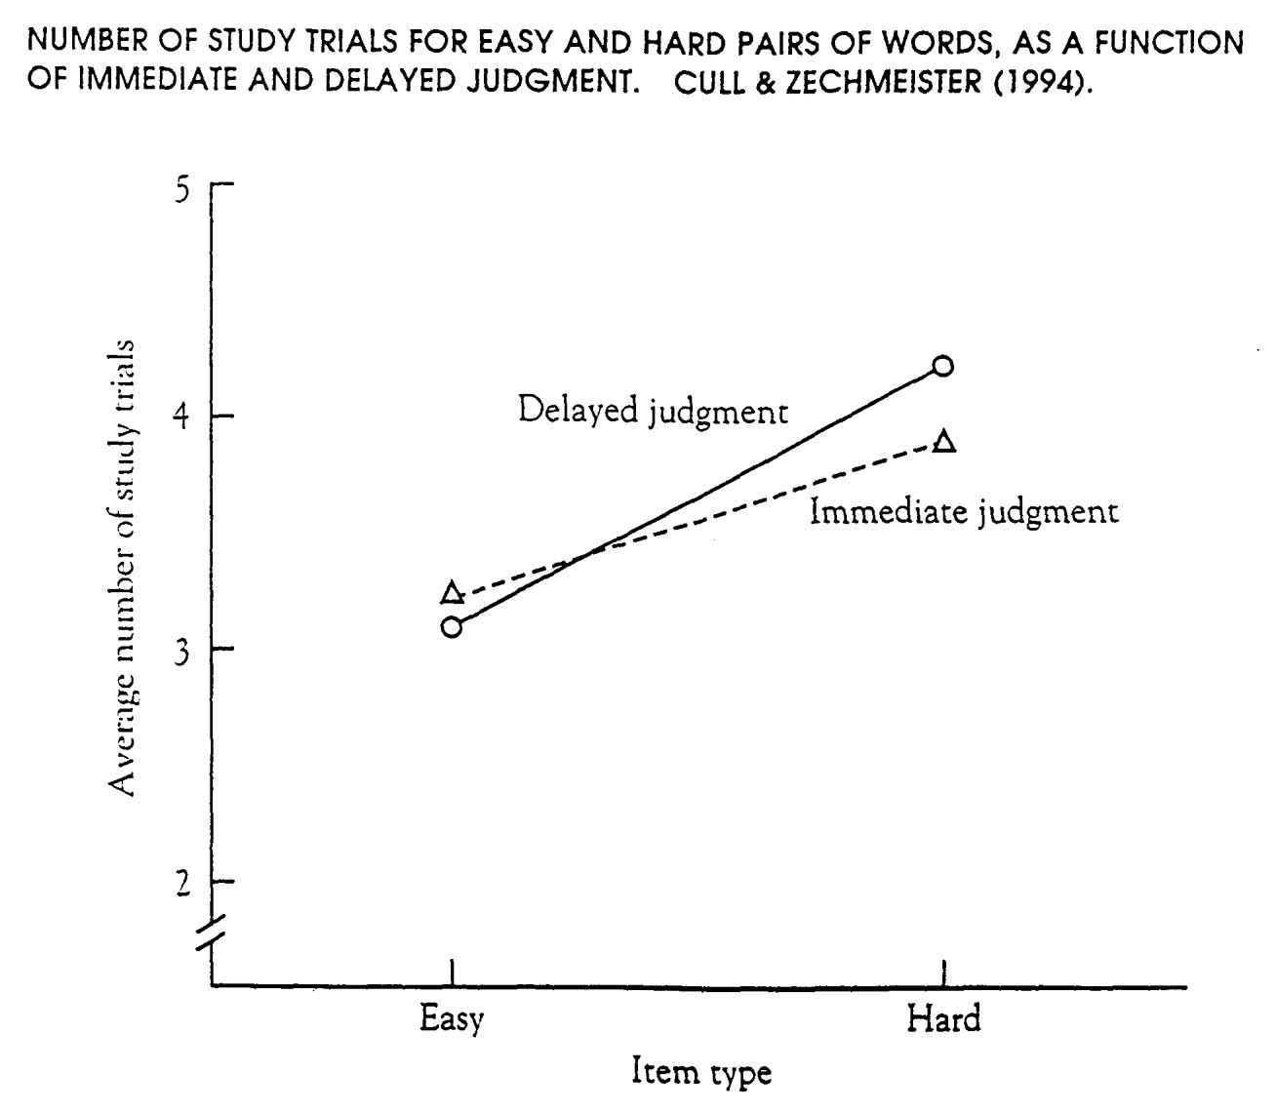

Slide 36
Tip-of-the-Tongue Phenomenon
A sensation we have when we’re confident that we know the word we’re searching for but we can’t recall it
Brown & McNeill (1966)
Sampan - Saipan, Siam, Cheyenne, Sarong, sanching, and symphoon
Why is this metacognition?

Slide 37
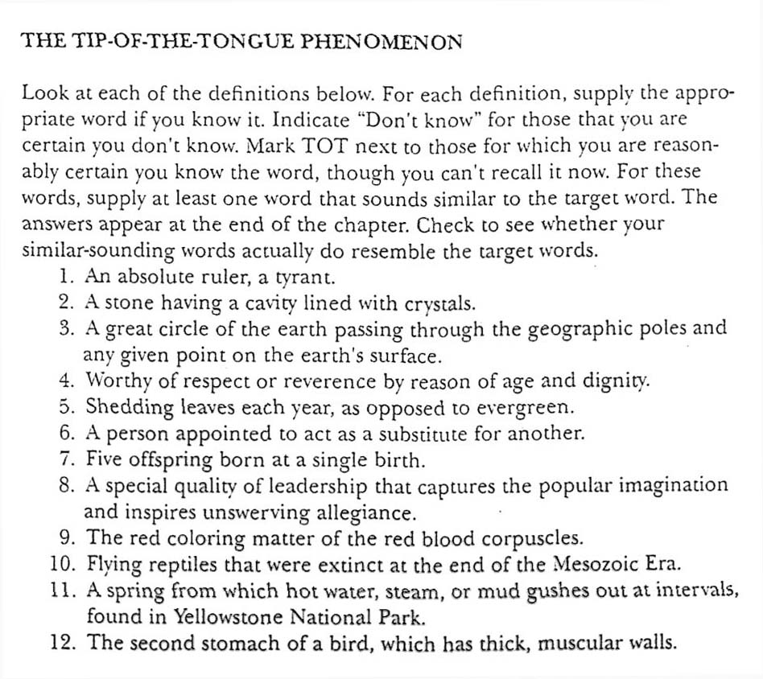

Slide 38
T.O.T. - More Recent Research
Brown (1991) - 25 years of research
1 experience / week
1st letter 50% - 70 %
# of syllables 47% - 83%
Feeling of knowing

Slide 39
Metacomprehension
Our knowledge/awareness of our reading comprehension
Metacomprehension Accuracy
  College students
  Pressley & Ghatala (1988)
  Higher metacomprehension ----> higher reading comprehension
Improving Metacognition
  Pretests
  Accurately assessing understanding
  Regulating your reading

Slide 40
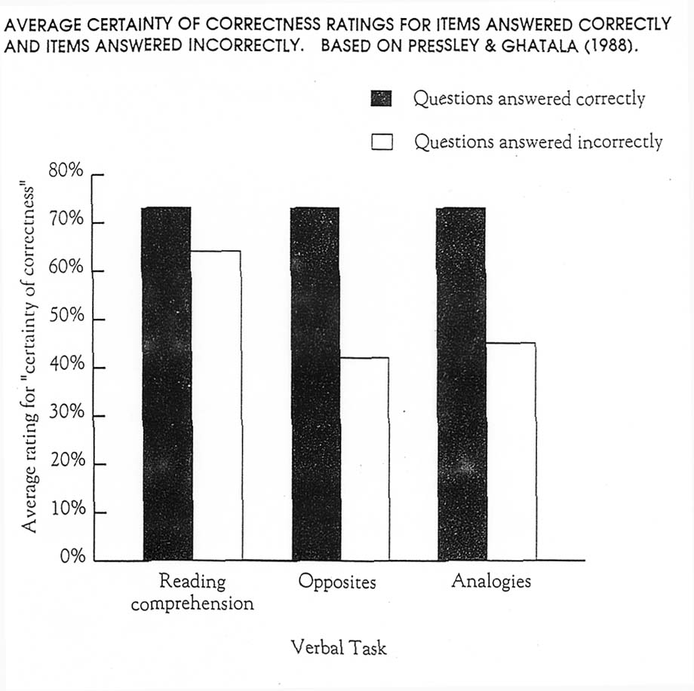

Slide 41
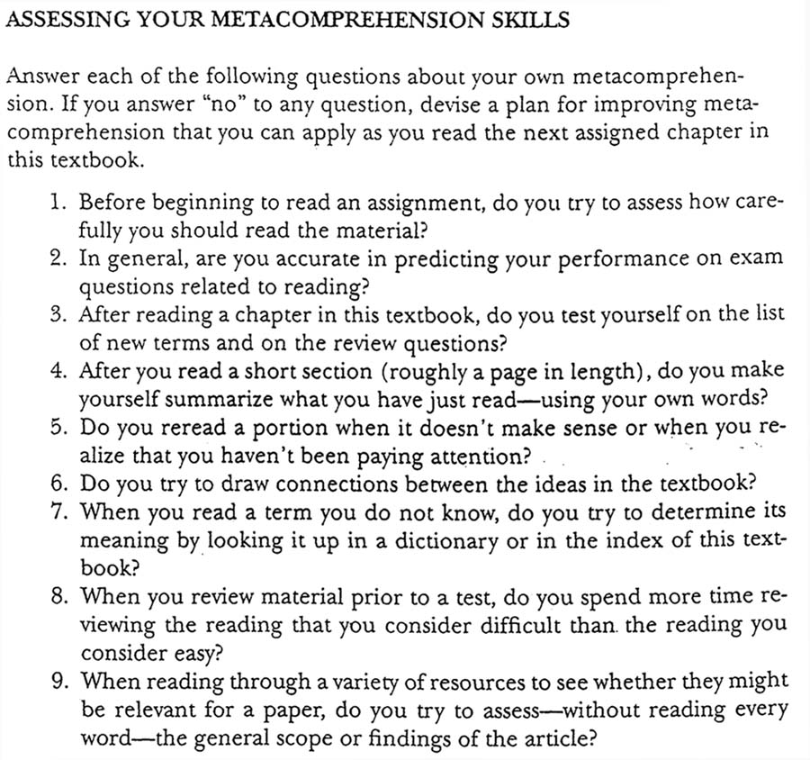

Slide 42
Improving Metacomprehension
Subjective Assessment vs. Objective Test
Pretest
Elaborative Processing
Regulation
  Connections
  Visual images
  Summarizing / outlining
  Questions

Slide 43
Answers to the TOT Definitions:
Despot
Geode
Meridian
Venerable
Deciduous
Surrogate
Quintuplets
Charisma
Hemoglobin
Pterodactyls
Geyser
gizzard

