Slide 1
Introduction to Language & Language Comprehension
The Nature of Language
  Background
  Phrase structure grammars
  Transformational grammars
  Factors affecting comprehension
  Neurolinguistics
Speech Perception
  Characteristics of speech perception
  Theories of speech perception

Slide 2
Introduction to Language & Language Comprehension
Basic Reading Processes
  Perceptual processes in reading
  Discovering the meaning of an unfamiliar word
  Reading and working memory
  Theories about the role of sound in word recognition

Slide 3
Language
75,000 - 100,000 words
Productive or generative nature of language
Psycholinguistics

Slide 4
Nature of Language
Phoneme
Morpheme
Semantics
Syntax
Pragmatics

Slide 5
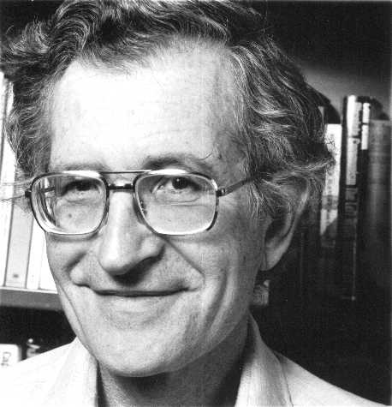
Noam Chomsky

Slide 6
Linguistics
Rejection of behaviorist notions of language
Emphasis on mental processes underlying language learning
Novelty of utterances
2 Major Claims
  Language knowledge innate
  Grammatical rules/system

Slide 7
Evidence
Same age of acquisition
Similar stages and length of time to acquire
Limited # of Grammars
Novel utterances
Evidence for rule use: Irregular past tense verbs

Slide 8
Evidence for Rule Use: Irregular past tense formation
Initially
  ‘go’ --> ‘went’
  ‘eat’ --> ‘ate’
Later (after acquiring regular past tense rule)
  ‘go’ --> ‘goed’
  ‘eat’ --> ‘eated’

Slide 9
Phrase Structure Grammars
Sentence decomposed into constituents by rewrite rules
“The young woman carried the heavy painting.”
Phrase structure rules
Why is this important?

Slide 10
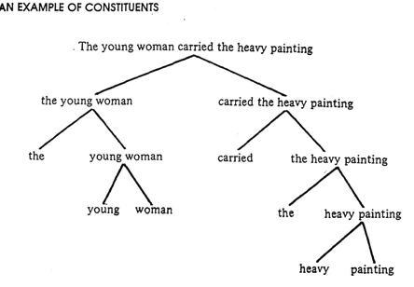
Constituent Structures

Slide 11
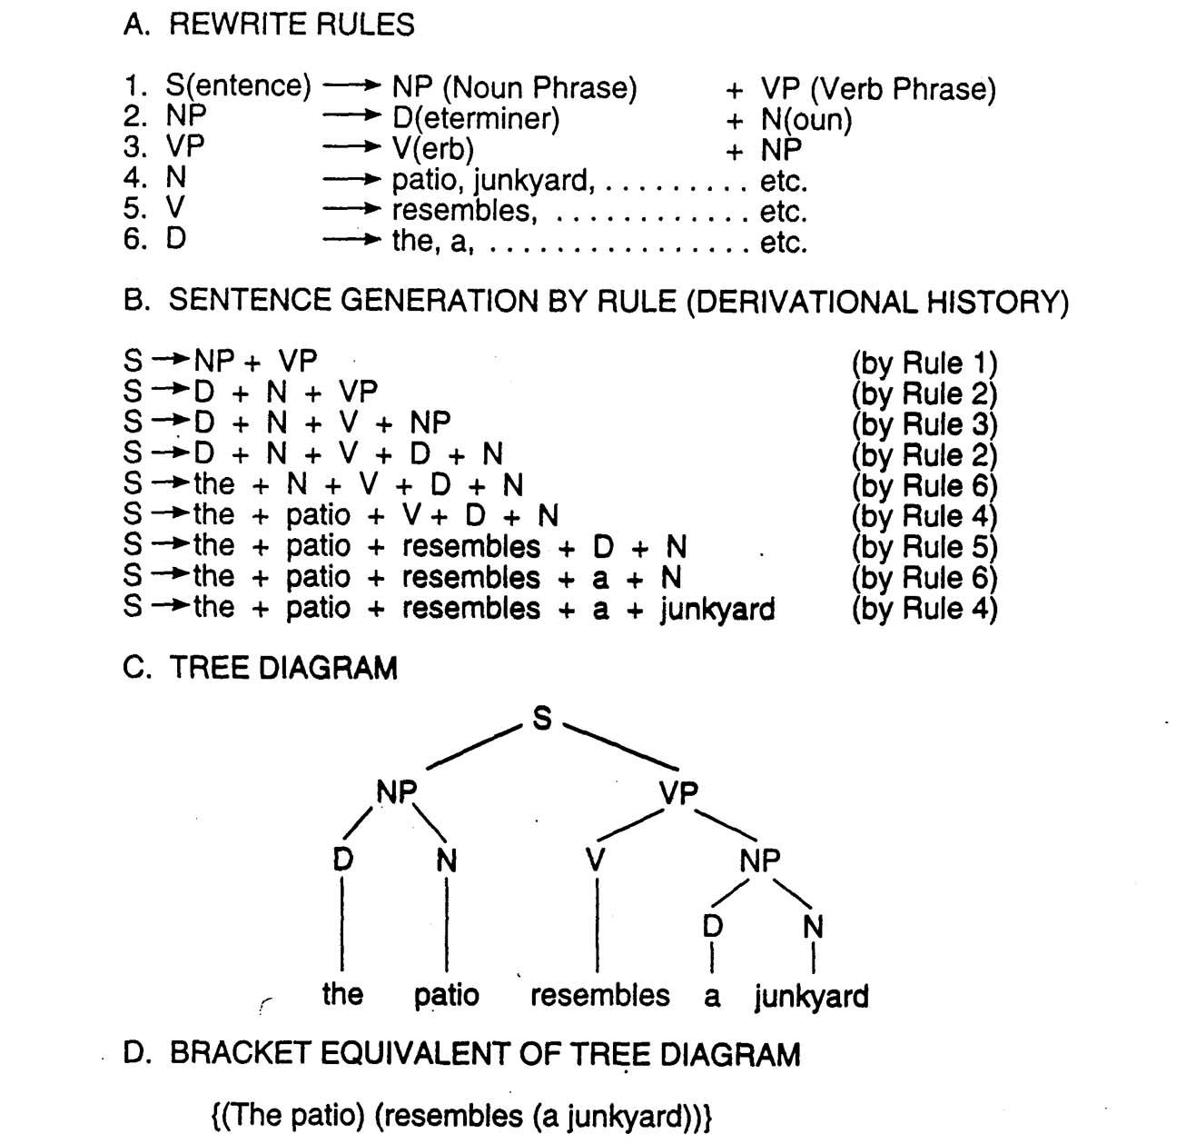
Phrase Structure Rewrite Rules

Slide 12
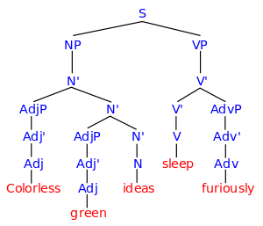
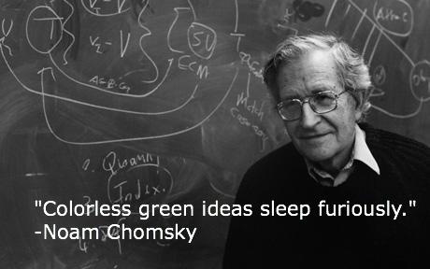
A semantically meaningless utterance can be syntactically well-formed

Slide 13
Transformational Grammar
Chomsky
Surface Structure vs. Deep Structure
Rules / Grammar that converts Deep Structure to Surface Structure
Deep Structure = more abstract meaning (structure) of sentence

Slide 14
Different surface structures but same deep structure:
Sue corrected the homework.
The homework was corrected by Sue.
or:
The boy kissed the girl.
The girl was kissed by the boy.
Was the girl kissed by the boy?

Slide 15
Same surface structure but different deep structures:
Visiting relatives can be a nuisance.
or
The shooting of the hunters was terrible.

Slide 16
Factors Affecting Comprehension
Negatives – e.g., Clark & Chase (1972)
Passive vs. Active Voice
Ambiguous Sentences

Slide 17
Clark & Chase (1972)
*
+
‘Star’ is above ‘plus’. Y/N ?
‘Plus’ isn’t above ‘star’. Y/N ?
Positive vs. Negative
-faster -slower
-fewer errors -more errors

Slide 18
Passive vs. Active
Chomsky
Active sentences 7 times more frequent
Implications for writing:
  “The study was run by three researchers”
  “Three researchers ran the study”

Slide 19
Neurolinguistics
Brain & Language
Aphasia
  Broca’s Aphasia
  Wernicke’s Aphasia
Recent Neuroscience Research
  PET scans
  ERPs

Slide 20
Hemisphere Specialization
Language localized in Left Hemisphere?
Yes / No
Left-Handers (50%) -------> process in RH or
Right-Handers (5%) both hemispheres
LH dominance:
  speech perception
  complex words – morphemic analysis
  Syntax
  Reading
RH participates in language production
  Interprets emotional tone
  Metaphor
  Subtle word meanings
Deaf individuals

Slide 21
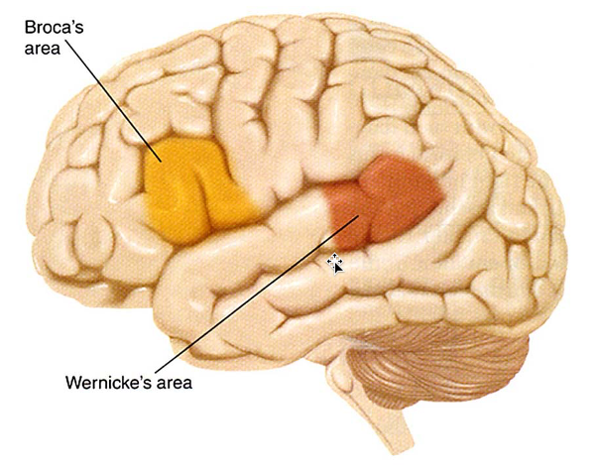
Two areas of the brain commonly associated with speech and aphasias

Slide 22
Examples of Broca’s & Wernicke’s Patients Speech
Broca’s Aphasia
  “Yes . . . Monday . . . Dad and Dick . . . Wednesday nine o’clock . . .ten o’clock doctors . . . and . . .teeth.” (Geschwind, 1980)
Wernicke’s Aphasia
  “Mother is away here working her work to get her better, but when she’s looking the two boys looking in the other part. She’s working another time.” (Geschwind, 1980)

Slide 23
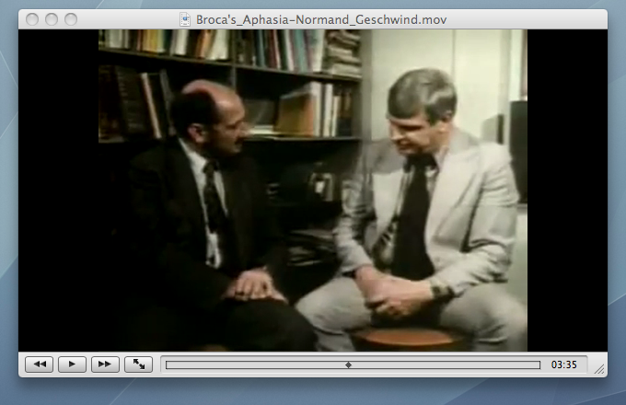
Broca’s Patient Video

Slide 24
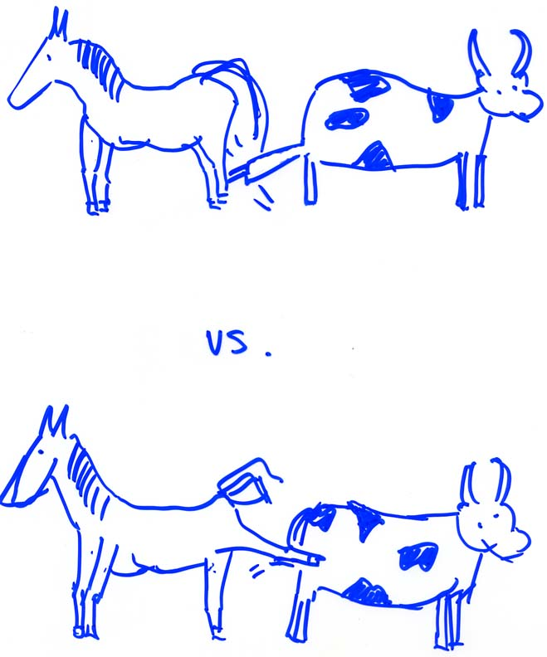
Example of a comprehesion task that trips up Broca’s Aphasics

Slide 25
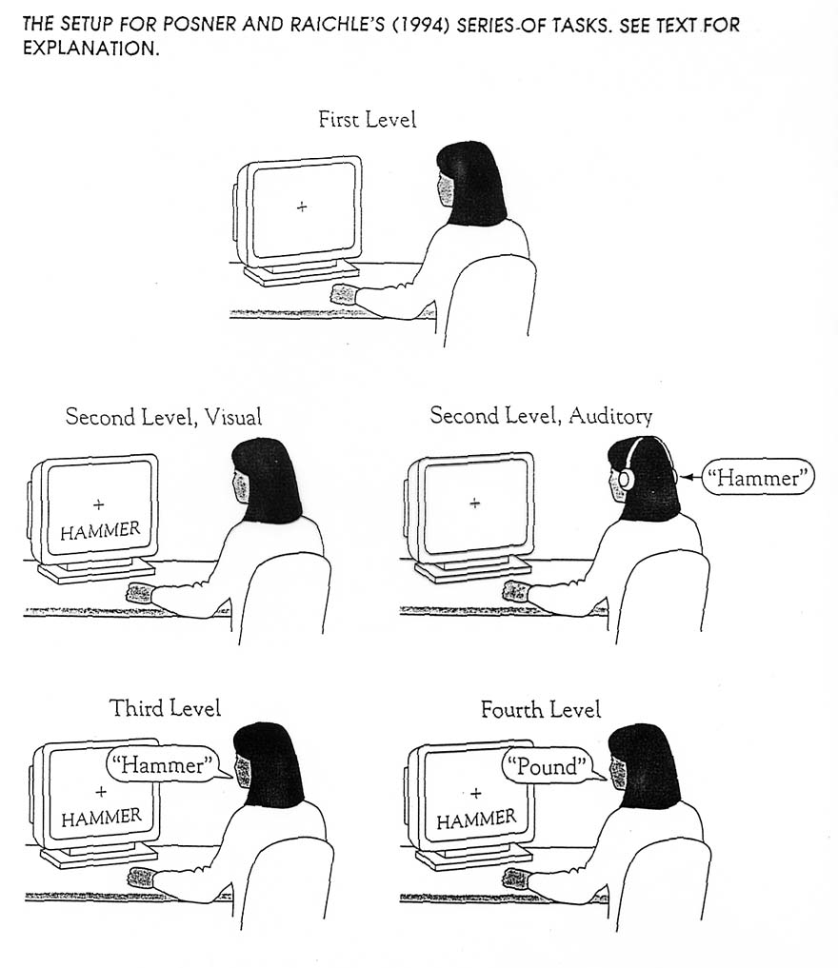
PET Scan Subtractive Methodology

Slide 26
Tasks
1st Level - subject looks at ‘+’
2nd Level
    Visual Task - subject looks at a word (e.g., ‘hammer’)
    Auditory Task - subject hears a word (e.g., ‘hammer’)
3rd Level - subject speaks / says the word (e.g., ‘hammer’)
4th Level - subject provides / says a word (verb) that describes / corresponds to function

Slide 27
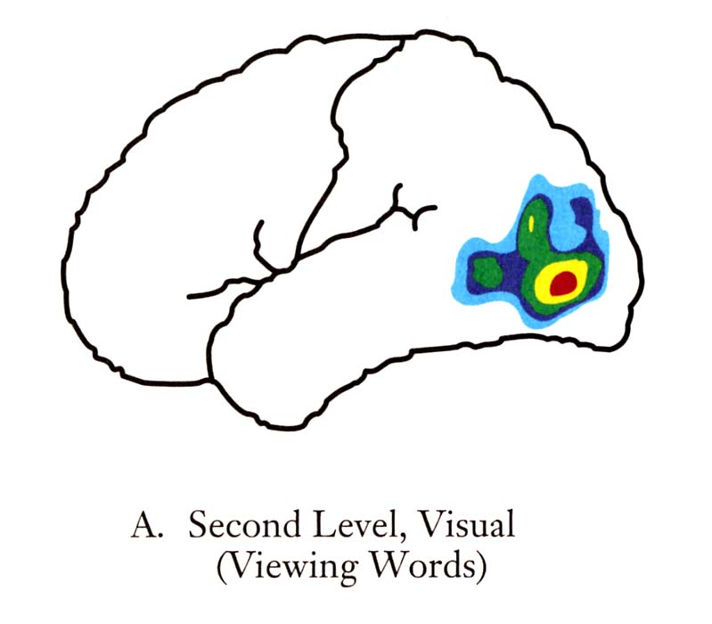
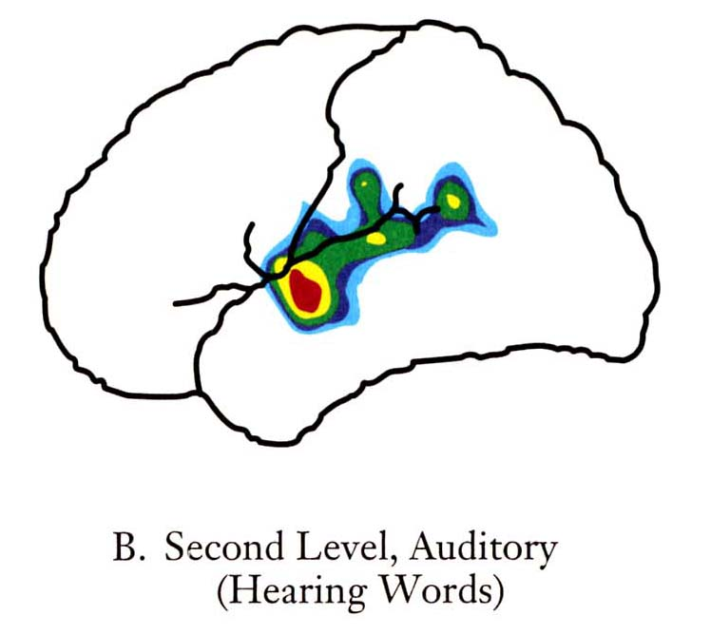
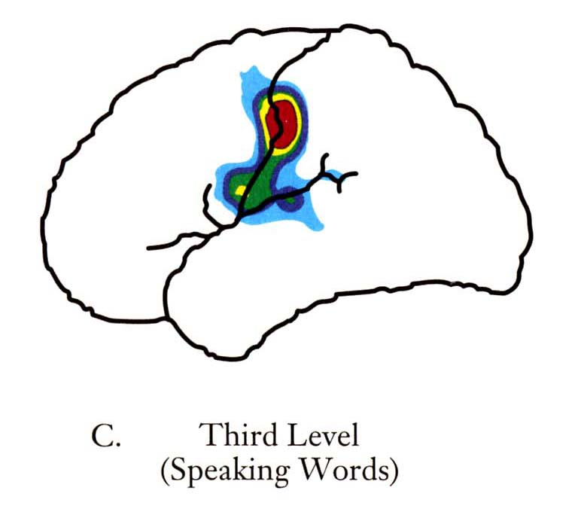
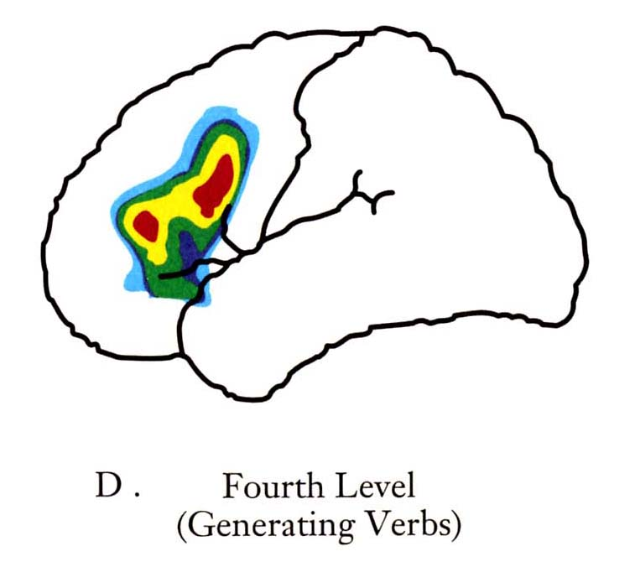
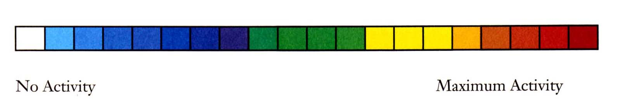
PET Scan Subtractive Methodology

Slide 28
Speech Perception
15 – 25 sounds/sec
Characteristics of Speech
  Variability (e.g. co-articulation)
  No Boundaries in speech signal
  Context allows filling in
  Visual cues - McGurk Effect

Slide 29
Warren and Warren (1970)
It was found that the *eel was on the axle.
It was found that the *eel was on the shoe.
It was found that the *eel was on the orange.
It was found that the *eel was on the table.

Slide 30
Phoneme Restoration Effect Demonstration

Slide 31
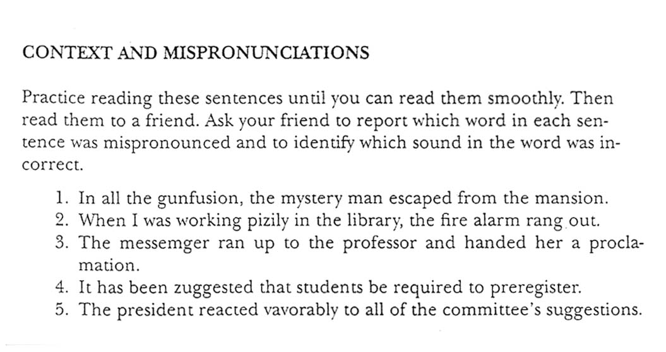

Slide 32
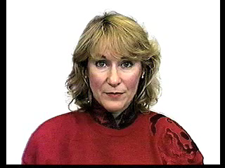
McGurk Effect

Slide 33
What’s going on ?
Sound recorded = “ba”
Lip movement = “ga”
You hear = “da”

Slide 34
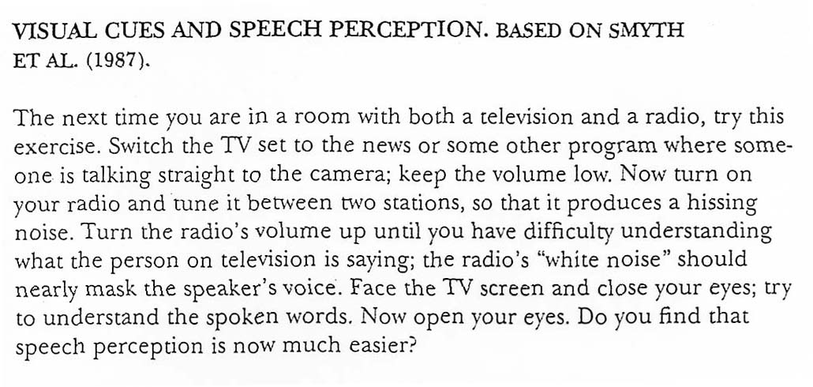

Slide 35
Perceptual Processes in Written versus Spoken Language?
Writing is spread out across space; speech is spread out across time
Readers can control the rate of input; listeners usually cannot
Readers can re-scan the written input; listeners must rely much more heavily on their working memory
Writing shows discrete boundaries between words; speech does not
Writing is confined to the words on a page; speech is supplemented by additional auditory cues—such as stressed words and variations in pace—that enrich the linguistic message.

Slide 36
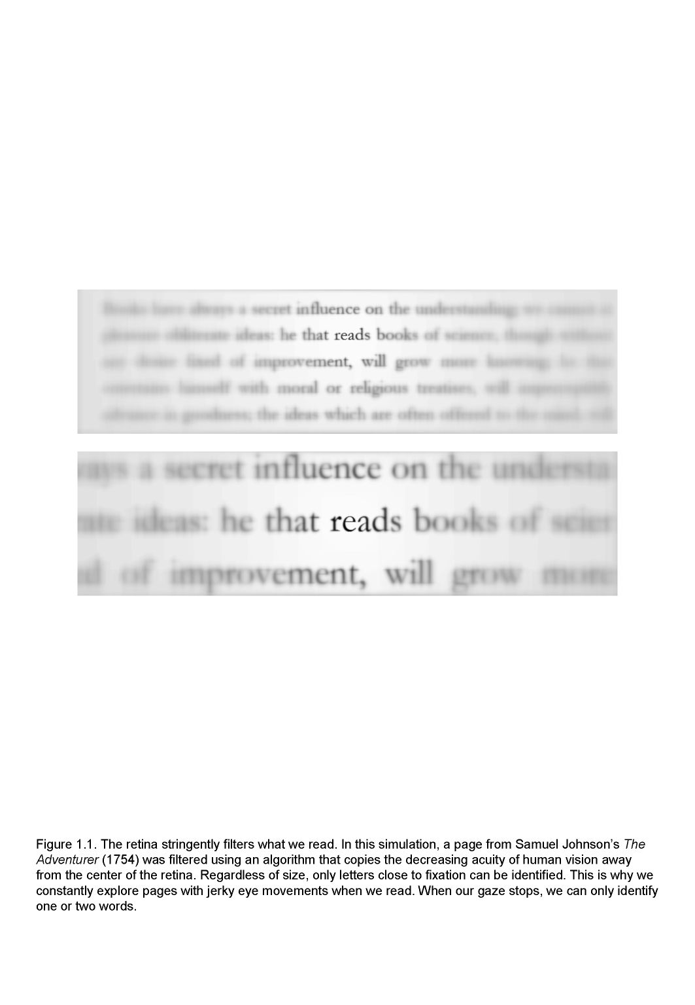
Notes:
The area of text that we can actually focus on is quite small. You cannot see detailed letter information outside of this area. This the foveal area.

Slide 37
Perceptual Processes in Reading
Saccades
Fixations
Moving window technique
Perceptual span
  4 letters to left
  15 letters to right

Slide 38
Saccadic Eye Movements
Predictable Patterns
No fixations on blank spaces
Jumps over short words, function words (e.g., ‘the’ and ‘of’) and predictable words
Misspelled or unusual words
Good readers
  larger jumps / fewer regressions
  shorter fixations

Slide 39
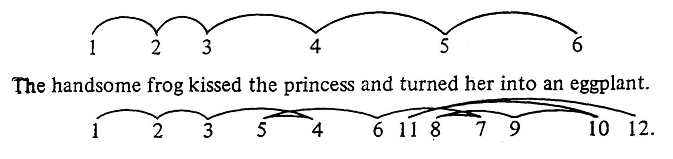
Eye movement patterns for a good reader (top numbers) and a poor reader (bottom numbers).
Watch several videos on my Psy321 website to see eye-tracker
recordings of readers’ eye movements and how reading works.
https://www.rcrutcher.on-rev.com/psy321n/links/

Slide 40
Theories About Word Recognition
Phonologically Mediated Hypothesis
Direct Access Hypothesis
Dual Route Hypothesis
“television” tel - e – vi - zun
“television”
“television”
tel - e - vi - zun

Slide 41
Evidence for Phonological-Mediation
Sounding out difficult material
‘insouciant’
‘pullulate’
Reading Tongue Twisters
Categorizing Homonyms (Van Orden 1987)
flowers
rose
rows

Slide 42
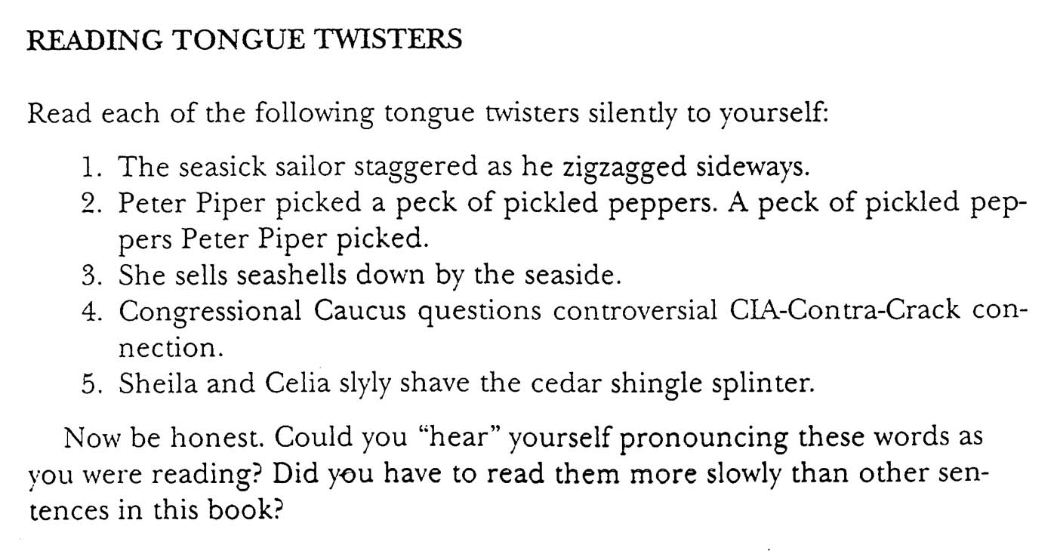

Slide 43
Direct Access Hypothesis Evidence
Homonyms
read - reed
sea - see
Bradshaw & Nettleton (1974)
mown - down
horse - worse
quart - part
Deep dyslexia

Slide 44
Dual-Route Hypothesis Evidence
Flexibility
Individual Differences
Word Characteristics
  Difficulty of words
  Unfamiliar vs. familiar
Children vs Adults

Slide 45
Implications for Teaching Reading
Whole-word approach
Phonics vs. phonemic awareness

Slide 46
