Slide 1
Introduction to Cognition
& Cognitive Psychology

Slide 2
What is cognition?

Slide 3
Cognition
The basic mental processes that are part of mind, for example: perception, attention, pattern recognition, memory, language, reasoning, etc.

Slide 5
Question
Answer this question as quickly as you can:
How many hands did Aristotle have?
What mental processes were involved in answering that question?

Slide 6
So…
How many hands did Aristotle have?
What did you write down?
What aspects of cognition were involved in that task?

Slide 7
What is Cognitive Psychology?

Slide 8
Our Definition of Cognitive Psychology
A specific theoretical approach to the study of mind (cognition) in which cognitive structures & processes are inferred from performance (behavior) on specific, carefully designed cognitive tasks.

Slide 9
Digit Span Demo

Slide 10
Digit Sequences I Read
3 7 1 (03)
4 9 8 2 (04)
7 8 4 6 3 (05)
5 8 1 4 9 6 (06)
2 4 5 3 8 7 1 (07)
6 9 1 4 3 8 2 5 (08)
4 7 5 3 9 8 1 7 4 (09)
3 1 9 6 8 2 3 5 4 6 (10)
5 4 7 5 6 3 9 8 1 4 3 (11)
2 9 6 4 2 5 8 4 3 9 1 5 (12)
6 9 8 2 5 3 4 7 4 9 5 4 3 (13)

Slide 11
What can we infer from your performance?
Short-Term vs. Long-term Memory
Capacity of STM
Duration of the memory
Type of Code

Slide 12
Key Ideas
Cognition (cognitive structures & processes) inferred from behavior (performance).
Cognitive process occur over time in a sequence (early versus late processing)
Cognitive processes occur at different levels (lower versus higher level processing)

Slide 13
Levels (low versus high) of Cognitive Structures/Processes
Perception
Attention
Pattern Recognition
Memory
Organization of Knowledge
Language
Reasoning
Problem Solving
Decision Making

Slide 14
Another Key Idea
Cognition or Memory and Thinking are conceptualized in Information Processing terms – a sequence of processing steps and a series of transformations as the information is transferred from one stage to the next.

Slide 15
Another Key Idea
Cognitive structures and processes (e.g. memory) can be decomposed (i.e. broken down) into simpler structures and processes (e.g. short-term memory vs. long-term memory)

Slide 16
Representations or Codes
System of signals used to represent something -- e.g. code for the alphabet
Cognitive Codes: e.g. the word ‘hand’ --> phonemic code (language sounds) vs semantic codes (conceptual meaning)
Neural Codes: e.g. the word ‘hand’ encoded as a pattern of light on the retina; meaning is encoded as a pattern or neural activity

Slide 17
Level of Description
Mental Level (your awareness)
Cognitive Level (inferred from behavior – i.e. abstract description)
Neural Level

Slide 18
Approaches to the Study of Mind (Cognition)
Philosophy
Introspection
Behaviorism
Cognitive Psychology
Cognitive Neuroscience

Slide 19
Timeline

Slide 20
Philosophy

Slide 21
The Philosophical Approach
Interest in the human memory and thought goes back to the Greeks and earlier
Plato, Aristotle, Descartes, Kant
Aristotle
  systematic observation of his own thinking
  Induce general laws of thought from self-observation
  Thinking corresponds to a sequence of associations

Slide 22
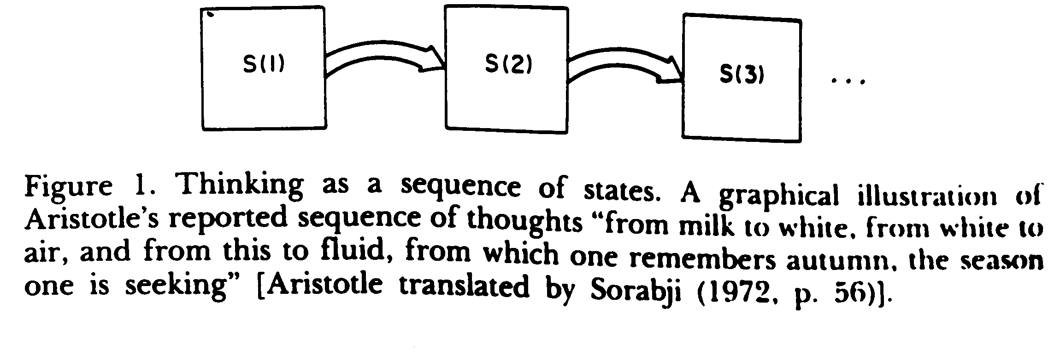
Thinking as a Sequence of States

Slide 23
Ideas from Philosophical Approach
Many cognitive issues and ideas began with philosophical investigation
Plato’s notion of ideal forms – innate ideas or knowledge (the nativist idea)
Aristotle’s notion that all knowledge derives from experience (“tabula rasa”).

Slide 24
Introspection

Slide 25
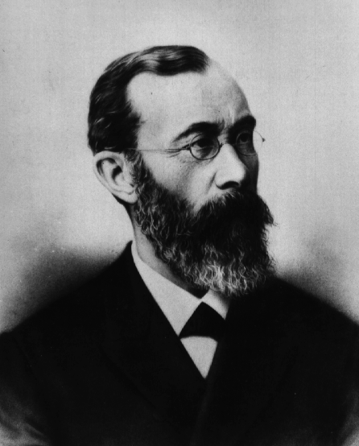
Wilhelm Wundt
“ Conscious processes and immediate experience”
Introspection or “self observation”
Rigorous Methods

Slide 26
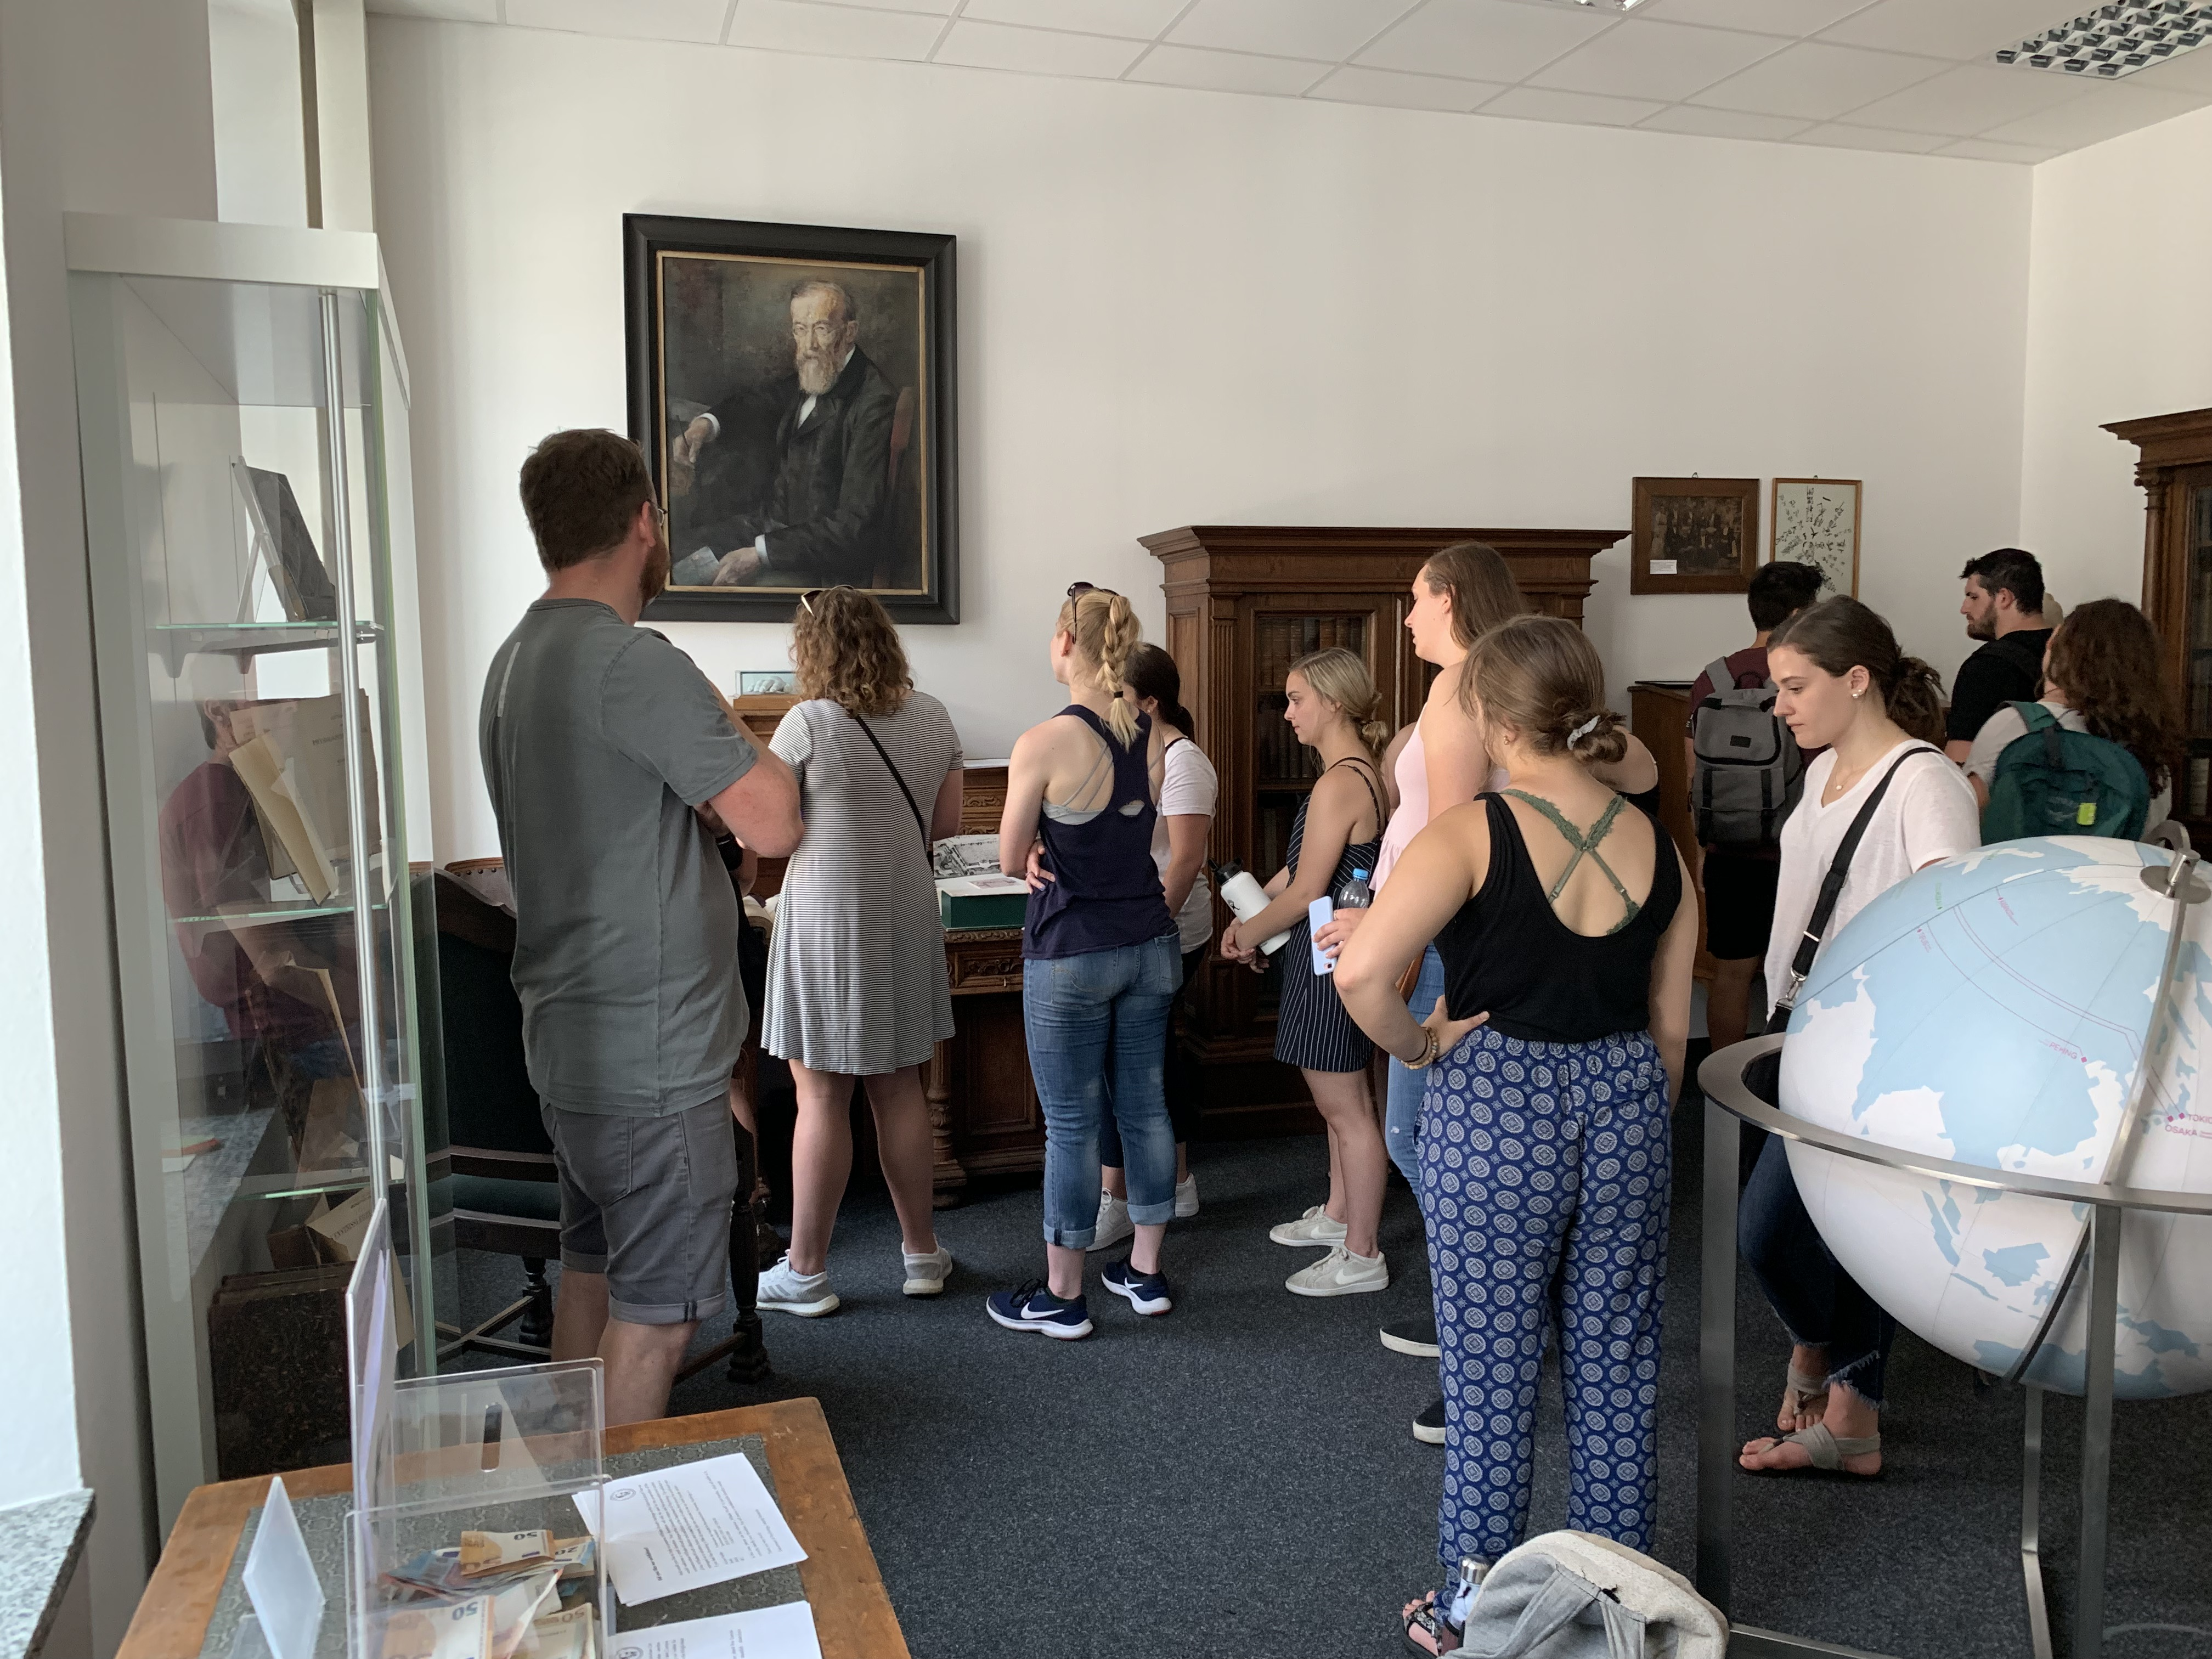
Wundt’s Lab 1

Slide 27
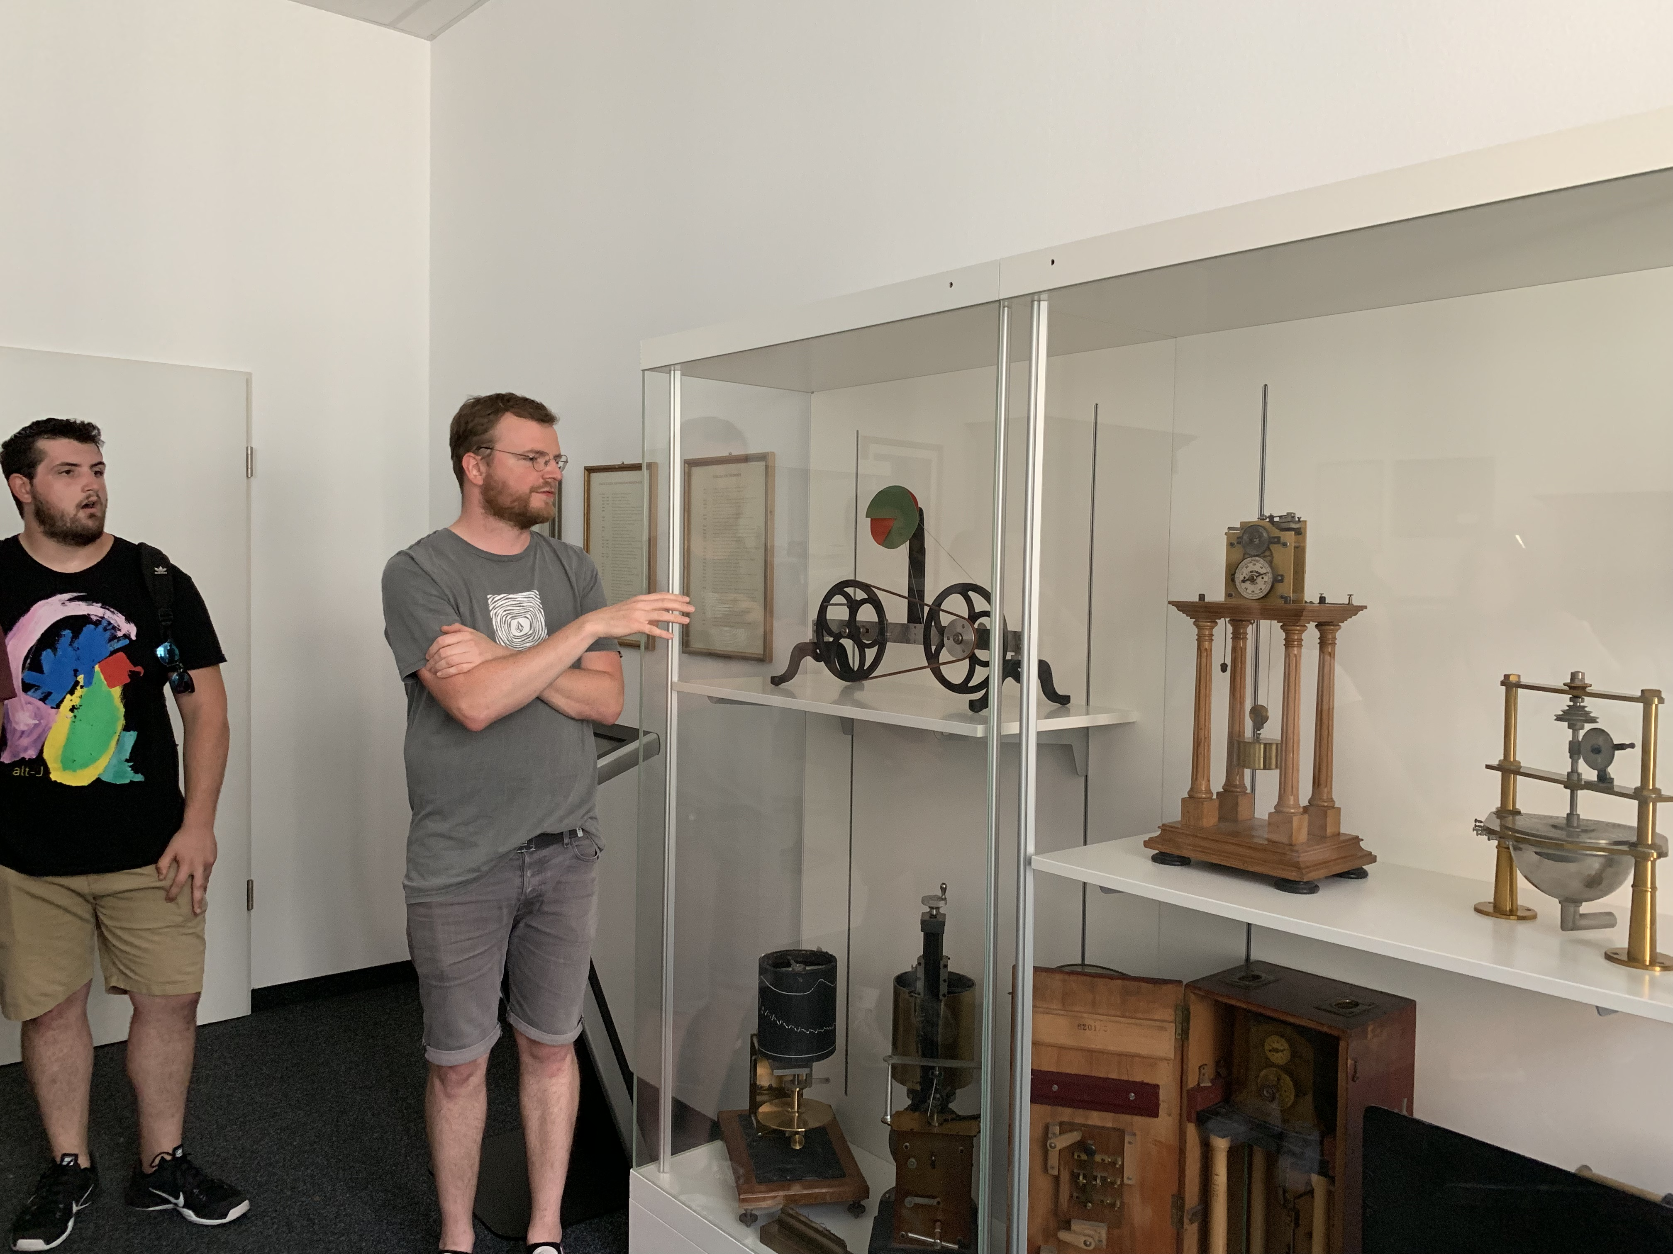
Wundt’s Lab 2

Slide 28
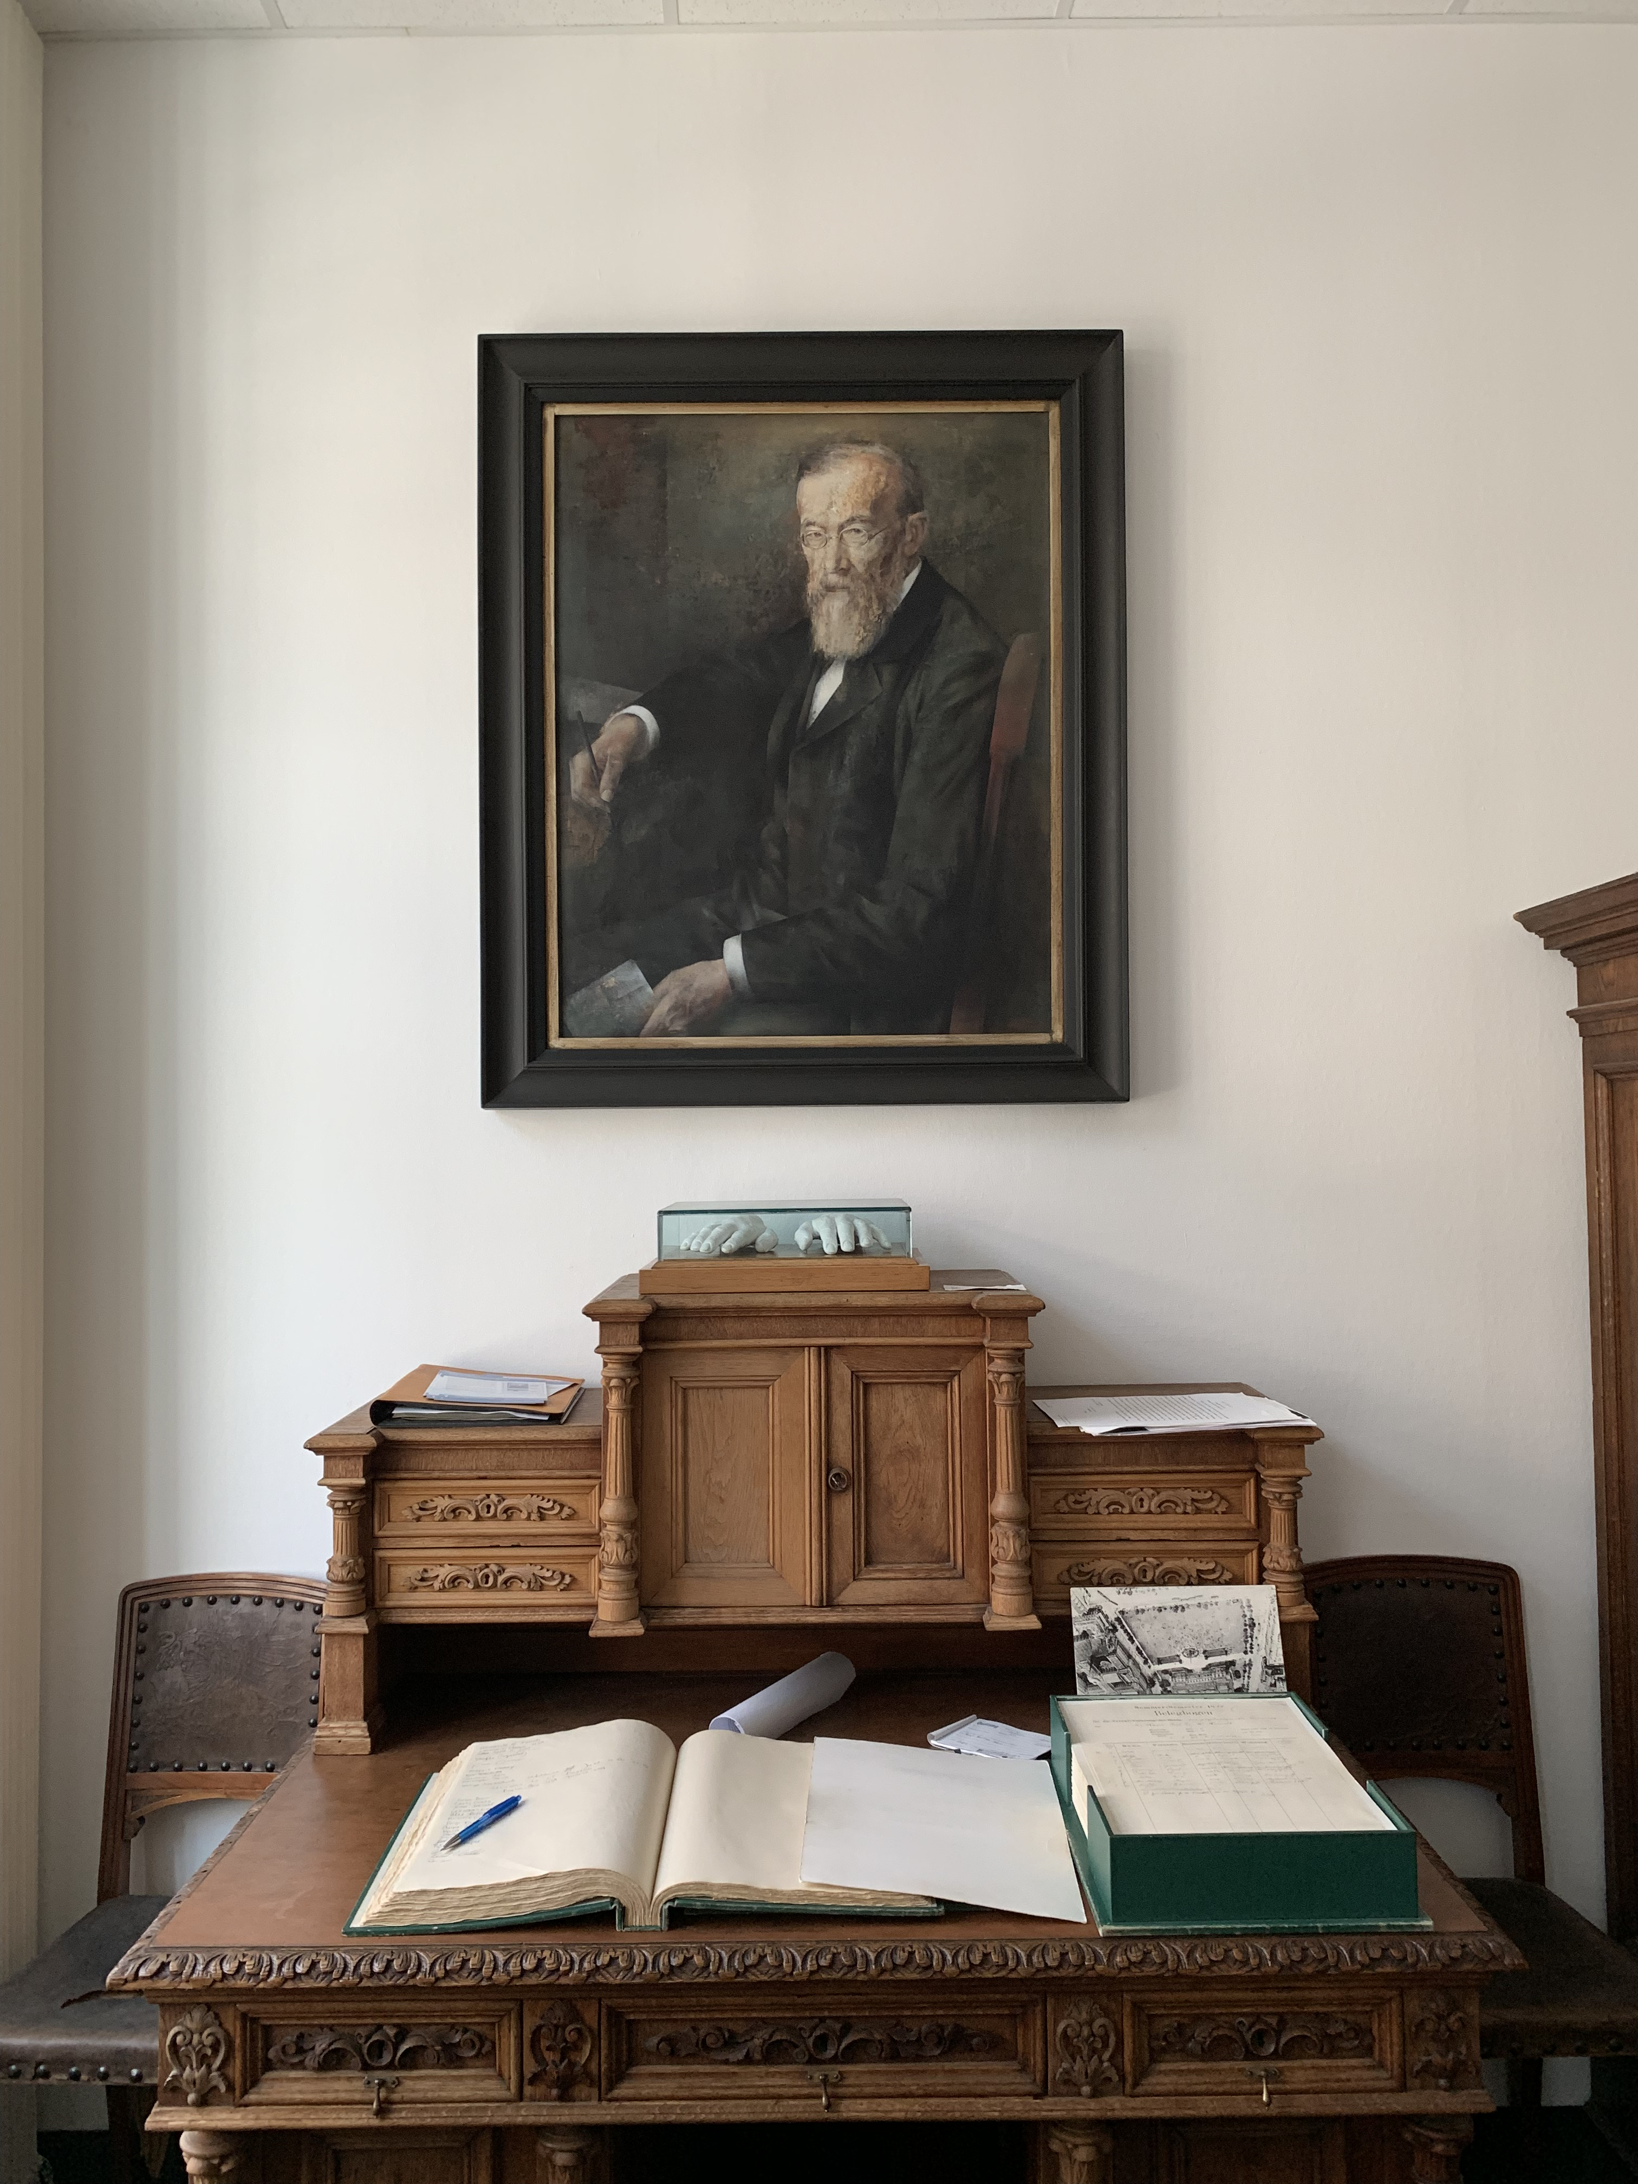
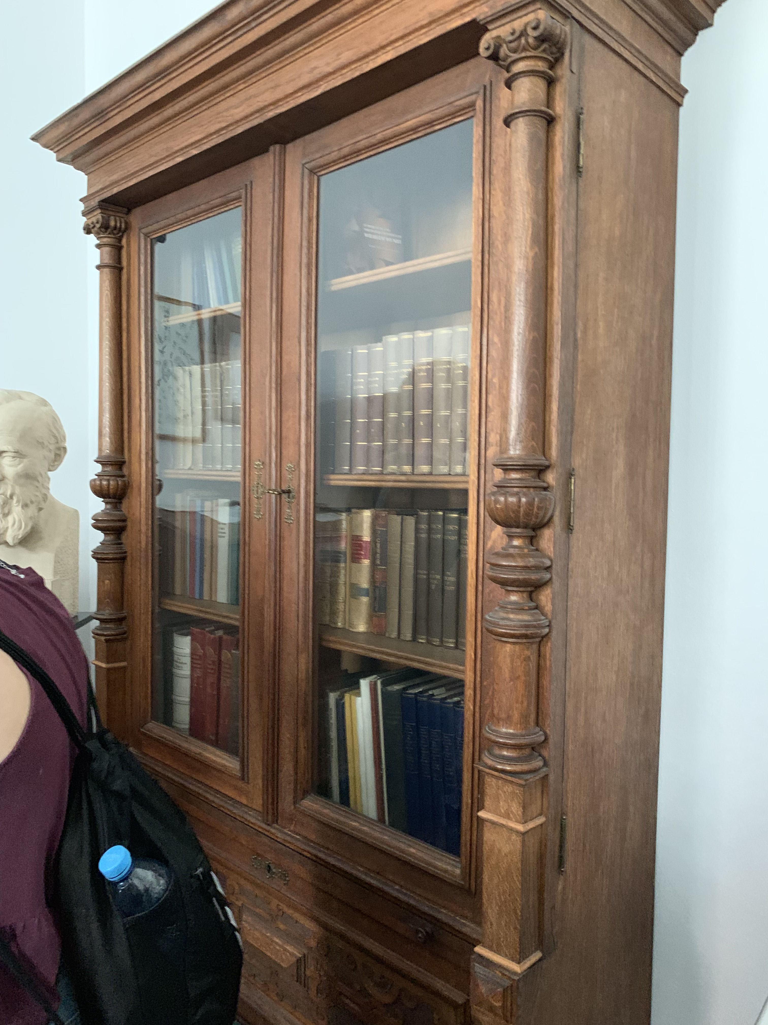
Wundt’s Lab 3

Slide 29
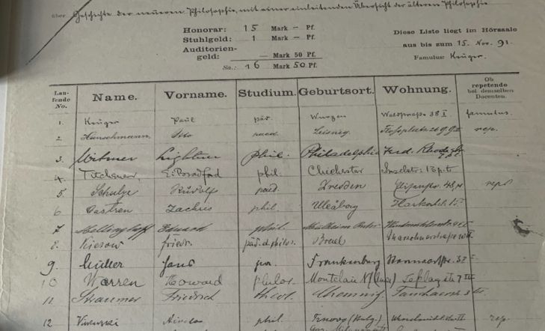
Wundt’s Lab 4

Slide 30
Titchener Comes to US

Slide 31
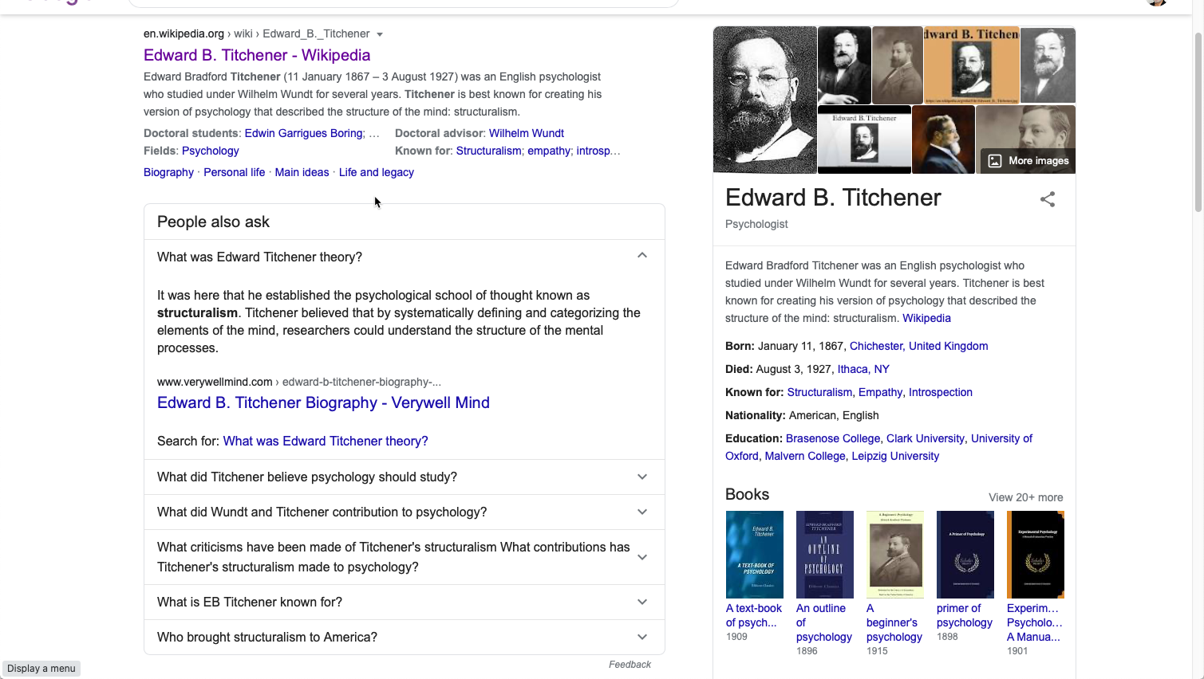
Edward Titchener

Slide 32
Behaviorism

Slide 33
Behaviorism – Principles 1
John B. Watson (1924)
Reaction to Introspection
Emphasis on observable, quantifiable behavior
No unobservables, no internal mental states, no images, ideas, or thoughts

Slide 34
Behaviorism – Principles 2
Psychology = Scientific study of behavior
Humans as passive reactors to external stimuli
“Tabular Rasa” - Environmental determinants of behavior
Rats in mazes, puzzle boxes, etc.

Slide 35
Behaviorism - Positive Contributions
Insistence on precise & careful definition of concepts
Operational Definition
  e.g. learning= # trials necessary to complete a maze with no errors
Experimental Controls

Slide 36
Back in Europe …

Slide 37
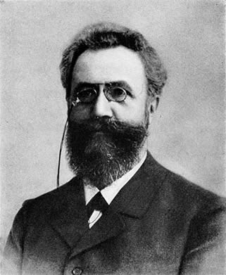
Herman Ebbinghaus
Study higher mental processes using scientific method
Process of association formation
Non-sense syllables
Savings Method

Slide 38
Nonsense Syllables
DAX
GIK
TEB
KOV
SUV
HET

Slide 39
Ebbinghaus’ Method
Learn list to 2 perfect recitations (# trials)
Set aside (varied delay)
Relearn (# trials)
Measurement of Savings
# Trials to Learn | - | # Trials to Relearn
# Trials to Learn

Slide 40
Measurement of Savings
# Trials to Learn | - | # Trials to Relearn
# Trials to Learn

Slide 41
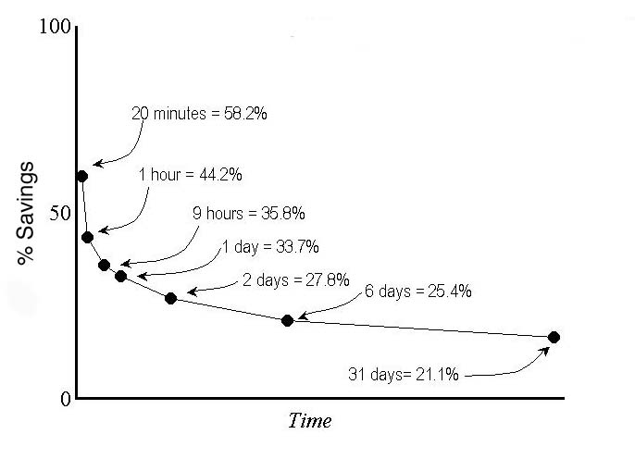
Forgetting Curve

Slide 42
Gestalt Psychology
Laws of organization
Law of proximity
Law of similarity
Insight problem solving

Slide 43
Law of Similarity
O O O O
X X X X
O O O O
X X X X

Slide 44
Law of Proximity
O O O O
X X X X
O O O O
X X X X

Slide 45
The Cognitive Revolution
Return to mentalistic ideas (1940’s and 50’s)
MIT – Sept. 11, 1956
Neisser’s book Cognitive Psychology (1967)
Information processing perspective
Diverse Influences/ Causes

Slide 46
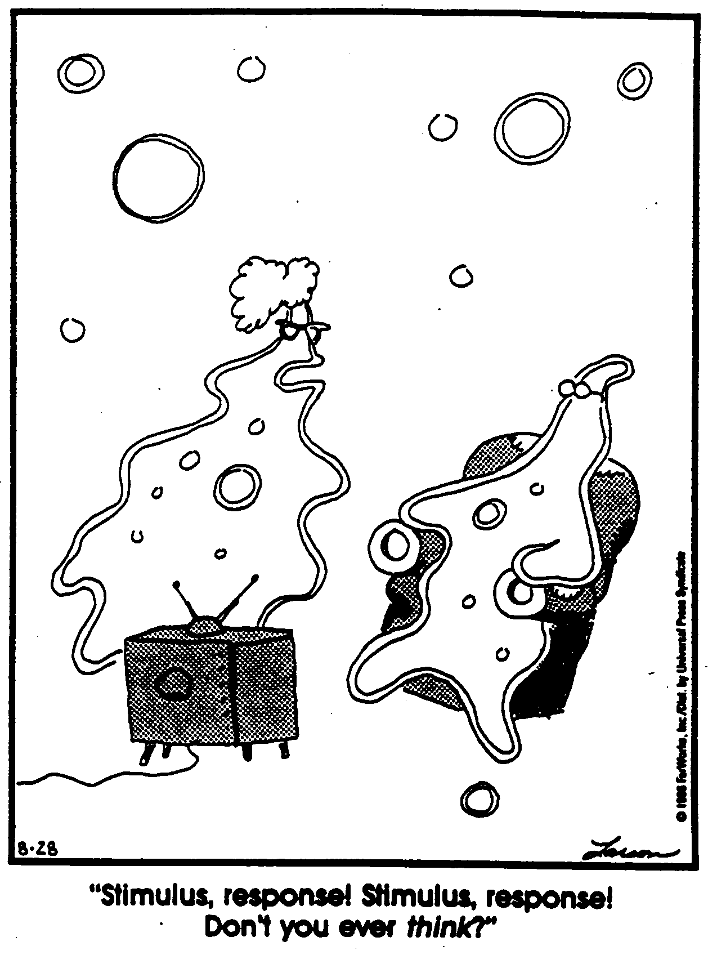
Stimulus-Response

Slide 47
Dissatisfaction with Behaviorism
Challenges to “tabular rasa”
Innate structure or knowledge
Complex human behavior not explainable in terms of stimulus-response relations alone

Slide 48
Verbal Learning
Flourishing of Ebbinghaus tradition
Different types of memory, memory organization, models
Active nature of learner--what is brought to learning
Formation of new associations --> Use of pre-existing associations.
Emphasis on Memory over learning

Slide 49
Bousfield (1953)
apple
bicycle
shirt
chair
banana
car
socks
desk
peach
truck
dress
couch
orange
train
hat
rug
desk
couch
chair
peach
apple
hat
shirt
dress
…
Etc.
Words presented in this order:
But recalled
In this order

Slide 50
Verbal Learning …
Existing memory associations lead to reorganization of words during recall
Mental Processes: rehearsal, storage, organization, retrieval
Acceptance of objective methods & procedures
But increased commitment to inferred processes -- e.g. encoding, storage, retrieval

Slide 51
New Disciplines Emphasizing Information Processing
Communications Theory
Information Processing
Computer Science

Slide 52
Communications Theory
Information processing idea
Similarity between communication devices and people
1st approximation analogy for psychology to describe mental processes
Channel, information processing filters, limited capacity, serial vs. parallel processing.

Slide 53
Information Theory
Information
Source
Transmitter
Channel
Receiver
Destination

Slide 54
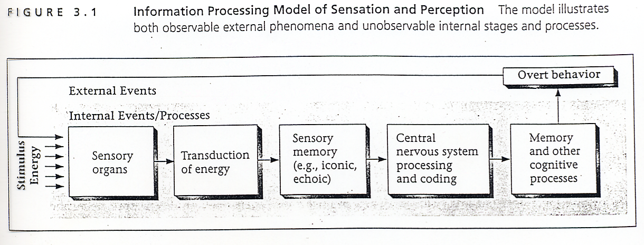
Information Processing of Sensation & Perception

Slide 55
Computers & Computer Science
Numerous contributions
Analogy of computers & humans
Both process information: Take in information, transform, manipulate, store, & output information (or some type of product--e.g. behavior)
Humans & computers as symbol manipulators

Slide 56
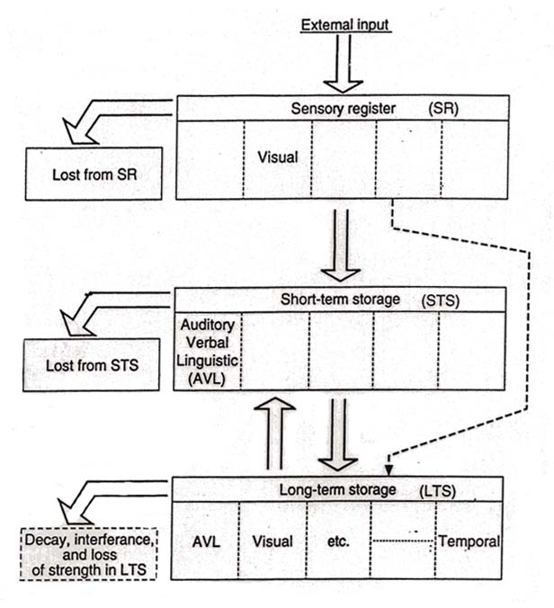
Atkinson & Shiffrin Memory Model

Slide 57
Many Contributions
Borrowing of concepts & characteristics of computers to describe human system: sensory store, short-term store, long-term store
Limited capacity--immediate memory & attention

Slide 58
Additional Contributions
Computer programs/processes analagous to mental processes
  Simulation modeling
  AI
Computer as tool
  Stimulus Presentation

Slide 59
Current Issues Related to Cognitive Psychology
Ecological Validity
Cognitive Science
Cognitive Neuroscience
Artificial Intelligence
Parallel Distributed Processing Approach

Slide 60
Cognitive Neuroscience
Investigates the relationships between brain structures & function and cognitive structures & processes.
Importance of Cognitive Task Analysis
Many New Tools/Techniques

Slide 61
Cognitive Neuroscience Techniques
Brain Lesions
Brain Imaging Techniques
  PET (Positron Emission Tomography)
  MRI (Magnetic Resonance Imaging)
  fMRI (functional Magnetic Resonance Imaging)
Event-Related Potential - ERP
Single-cell Recording Technique

Slide 62
PET Scanner vs. MRI Scanner

Slide 63
fMRI Scan

Slide 64
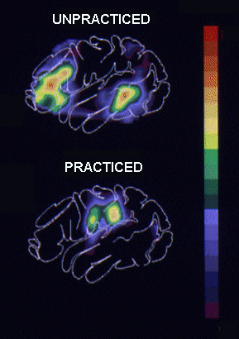
PET Scan
PET Scan while listening to a language task (unpracticed)
versus
PET Scan after practice with on the same language task (practiced)

Slide 65
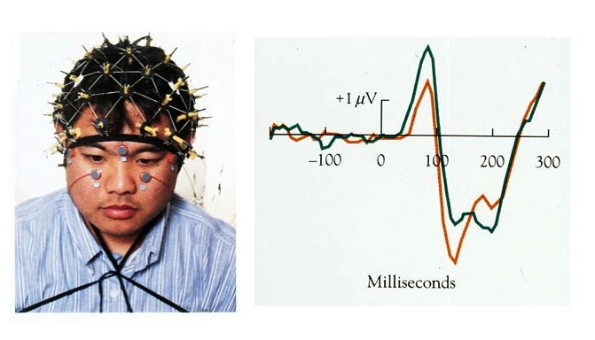
Event-Related Potentials

Slide 66
Artificial Intelligence
Machine Metaphor
Artificial Intelligence (Pure AI) vs.
Computer Simulation (Weak AI)

Slide 67
PDP - Parallel Distributed Processing
Cognitive processes can be understood in terms of networks of ‘neuron-like’ units
Connectionism vs. neural networks
Parallel vs. Serial Distinction

Slide 68
Themes
Cognitive processes are active
Cognitive processes remarkably efficient & accurate
Cognitive processes handle positive information better than negative
Cognitive processes are Interrelated
Many cognitive processes rely on both bottom-up and top-down processing

Slide 69
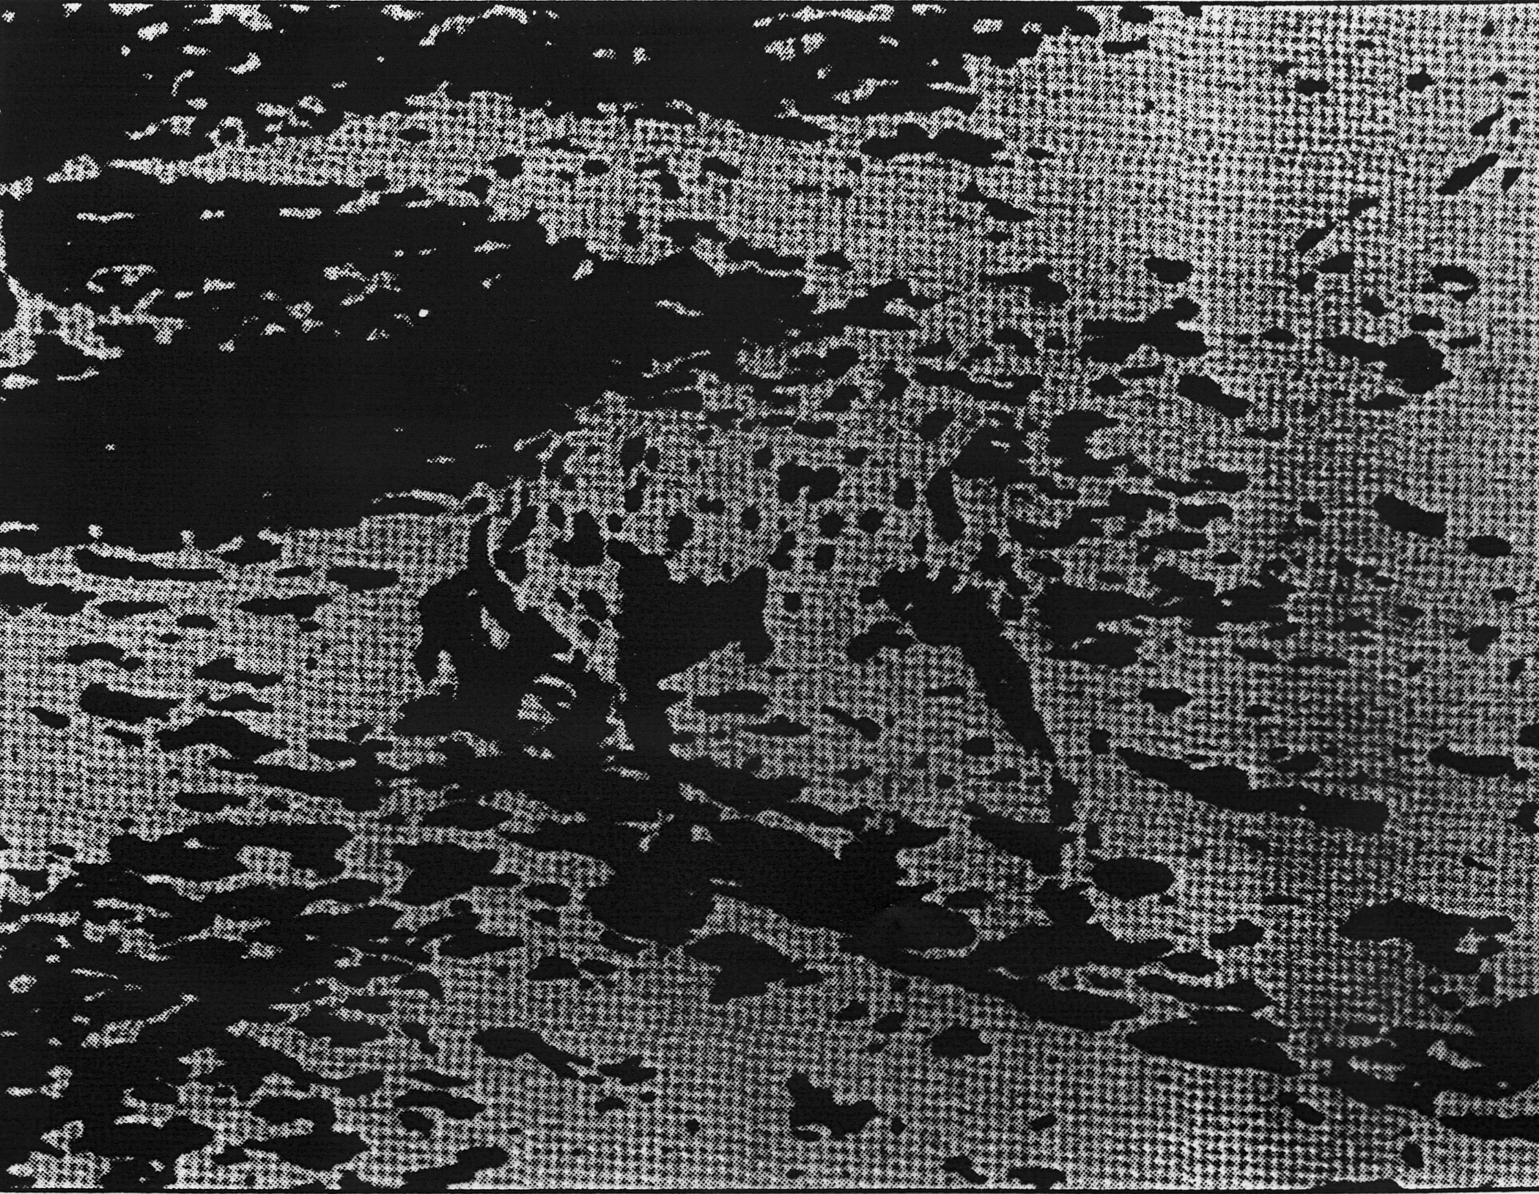
What do you see?

Slide 70

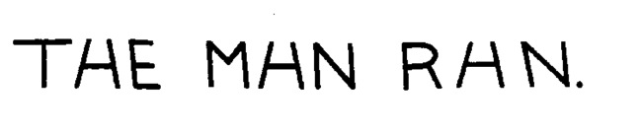
What letter is this?

